Slide 1
viiaPackage basics
Workshop - Day 2
Marijn Drillenburg and Reinier Ringers
March 23rd & 30th 2022
Internal use only

Slide 2
Contents of the workshop – Day 2
Recap
Fixed base analyses
Loads and supports
Eigenvalue analysis
Servers
The VIIA team
Automating team
Technical masters
Knowledge team
Taskforces
Flexbase analyses
Loads and supports
Result handling: Geo-output
Strengthening measures
Reporting
BSC
TVA
Appendices

Slide 3
Recap
Modelscript
Generate json

Slide 4
Fixed base analyses – Loading
Protocol
Main script
Load the model
Convert imposed loads to self weight for fixed base analyses (A1-A4)
Make sure to
project = viia_create_project(project_name='XXXX', version_nr=1)
project.viia_read_dump('model/XXXX-model', False)
# Convert imposed loads to self weight (as extra density), imposed loads are created in modelscript project.viia_convert_imposed_loads_to_self_weight() # Create the load combination for dead load (static situation) project.viia_create_loadcombination_static()

Slide 5
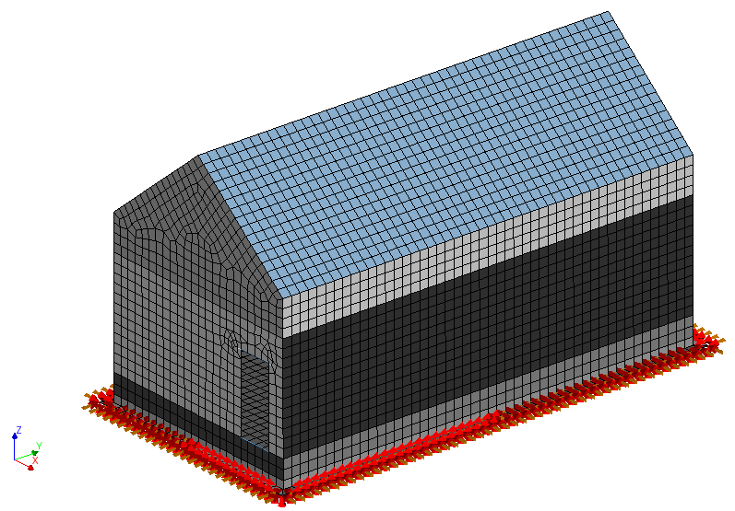
Fixed base analyses – Supports
Protocol
Create fixed base supports (example for shallow foundations)
Provide numerical constraint for columns and beams
# Add fixed base supports for shallow foundation (to fstrip collection) project.viia_create_supports('FixedBase’)
# Add boundary springs which prevent beams and columns from spinning project.viia_create_all_boundary_springs_for_static_analysis(spring_stiffness=50)

Slide 6
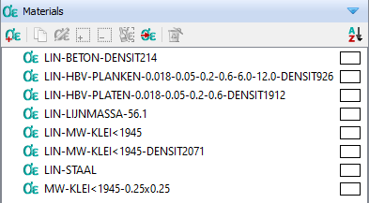
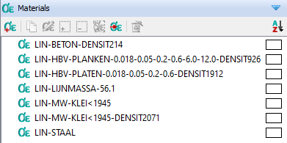
Fixed base analyses – Linear materials
Protocol
Convert to linear material properties
(and back)
# For fixed base analysis set the materials (temporarily to linear) project.viia_linear_properties()
project.viia_non_linear_properties()

Slide 7
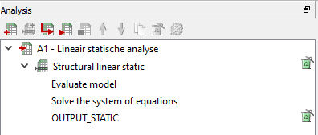
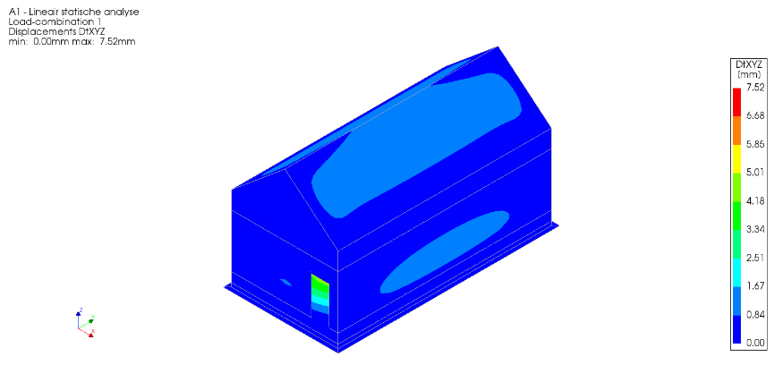
Fixed base analyses – Static
Protocol
Run static linear elastic analysis (A1)
Select run = True to run directly in DIANA and handle results
# Linear elastic static calculation (step A1 protocol) project.viia_analysis(analysis_nr='A1', run=True)
00:00:00 Out-file of A1 - Lineair statische analyse moved to analysis folder.
00:00:00 Result-file of A1 - Lineair statische analyse is locked, a copy is made in analysis folder.
00:00:00 The sum of the vertical loads is 829.3 kN.
00:00:00 The center of mass is x: 2.993 m and y: 6.021 m.
00:00:00 Runtime of A1: 24.5 s

Slide 8
Fixed base analyses – Booleans mainscript
# Boolean to add boundary springs during static analysis boundary_spring_static = False # Analysis analysis = ['A1'] num_modes = 100 signal = ['S1'] run_analysis = True pictures = True # Boolean for mesh check mesh_check = True # Boolean for applying connections detailing = True # Boolean for report creation, set to True to create report report = False governing_analysis = 'S1' # Boolean for cost quantities cost_quantities = False
Analysis
Select analysis from A1, A2, A3, A4, A7, A10, A12, A13, A15.
Multiple inputs allowed.
Num_modes
Select the number of modes for A3 and/or A7.
Signal
Select analysis from S1, S2, S3, S4, S5, S6, S7, S8, S9, S10, S11.
Multiple inputs allowed.
Pictures
Create model pictures. This will be extended for result pictures, when you don’t want to generate result pictures when running analysis.
Cost_quantities
Generate and send cost key figures to cost engineer.

Slide 9
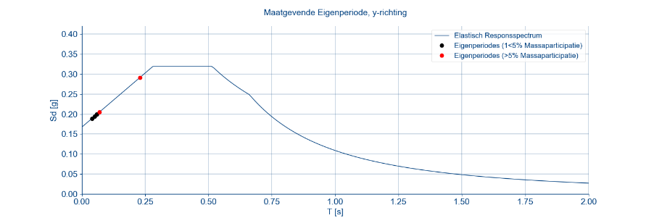
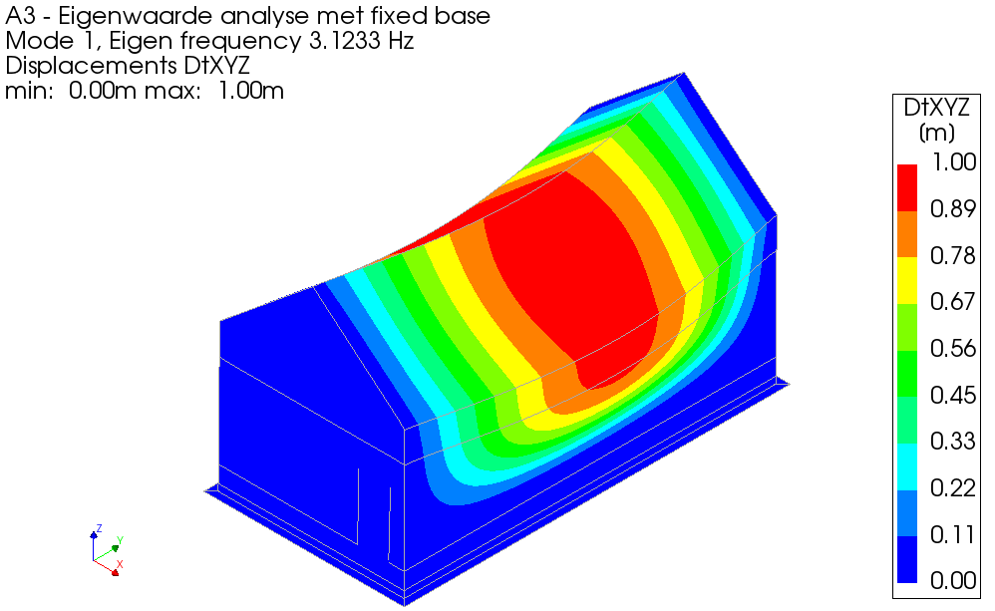
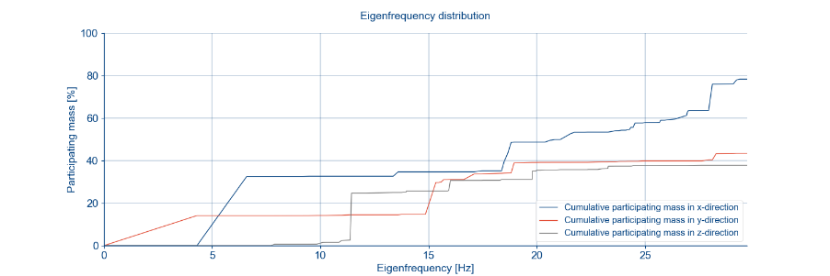
Fixed base analyses – Exercise 5
Run the eigenfrequency analysis

Slide 10
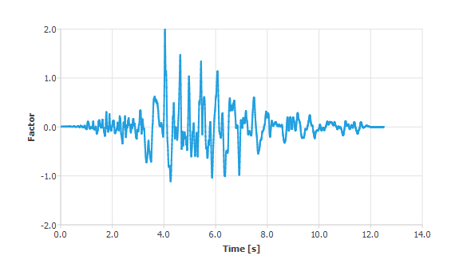
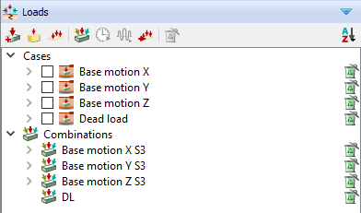
Fixed base analyses – LTH
Protocol
Apply the base motions
factor * ags * importance_factor * nlth_factor
Importance factor (Consequence class in MYVIIA)
CC1=1.0, CC2=1.1, CC3=1.2
NLTH factor 1.1 (7 signals)
ags (MYVIIA)
NEN cluster (MYVIIA)
9.8432532967 m/s² * 0.1672g/1g * 1.1 * 1.1 = 1.9914 m/s²
project.viia_create_loads('Base motion') project.viia_add_basemotion_signals() project.viia_create_loadcombination_base_motion(‘S1')

Slide 11
VIIA Servers
Protocol
Request access to Reinier or Jurriaan
WPS will create SZ1 credentials
We will provide access to the server
Move files: \\NLRTMGHPAPS004\exchange
Policy
Stick to folder naming
Don’t use as external disk
Close all applications when you leave
Empty recycle bin
Sign out

Slide 12
23 March 2022

Slide 13
The VIIA team – Proposal
Consequence class
The process of an object
Tender
Size
Complexity
Client NCG
VIIA (MT)
Budget
Proposal
MRS/NLTH/REF
Objectparts
Scope

Slide 14
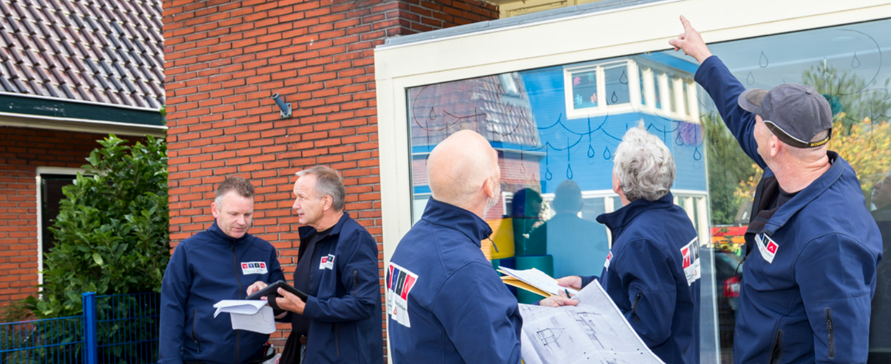
The VIIA team – Object
The process of an object
Tender
Desk study
Inspection
Inspection report
Proposal

Slide 15
The VIIA team – Object
The process of an object
Tender
Engineering
Cost engineer
Editors
Proposal
Geo

Slide 16
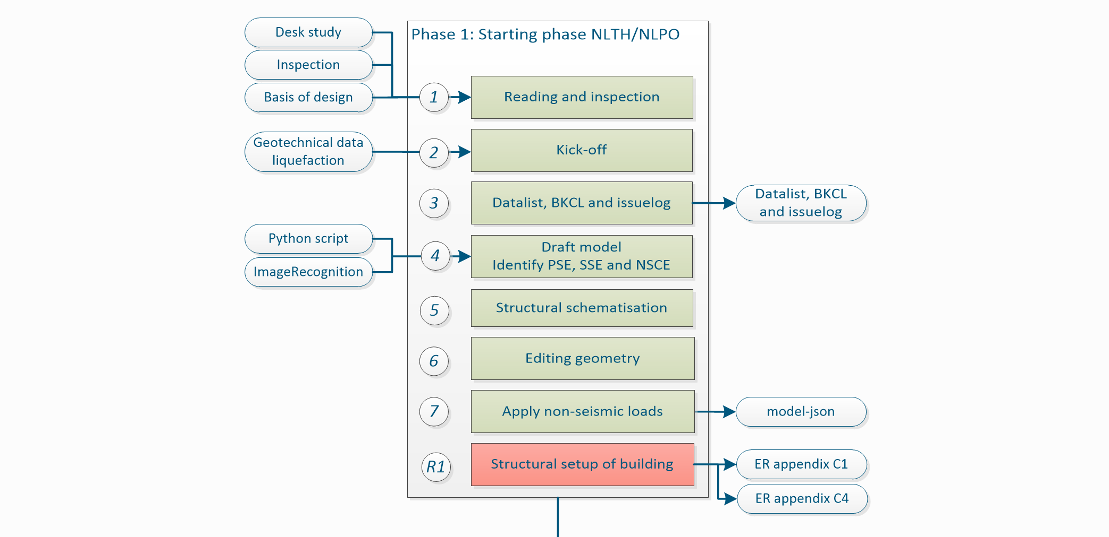
The VIIA team – Engineering
The process of an object
Tender

Slide 17
The VIIA team – Engineering
The process of an object
Tender

Slide 18
The VIIA team – Engineering
The process of an object
Tender

Slide 19
The VIIA team – Engineering
The process of an object
Tender

Slide 20
The VIIA team – Engineering
The process of an object
Tender

Slide 21
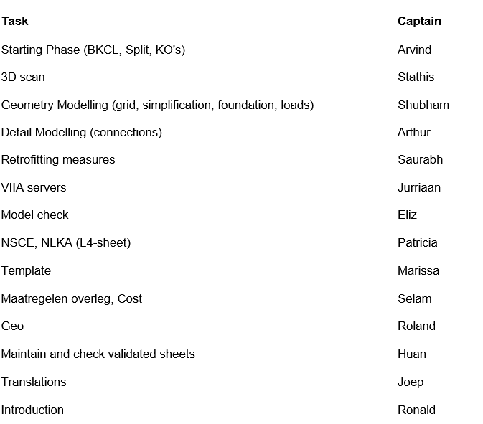
The VIIA team – Engineering
Team
Technical master
Tender
Task force

Slide 22
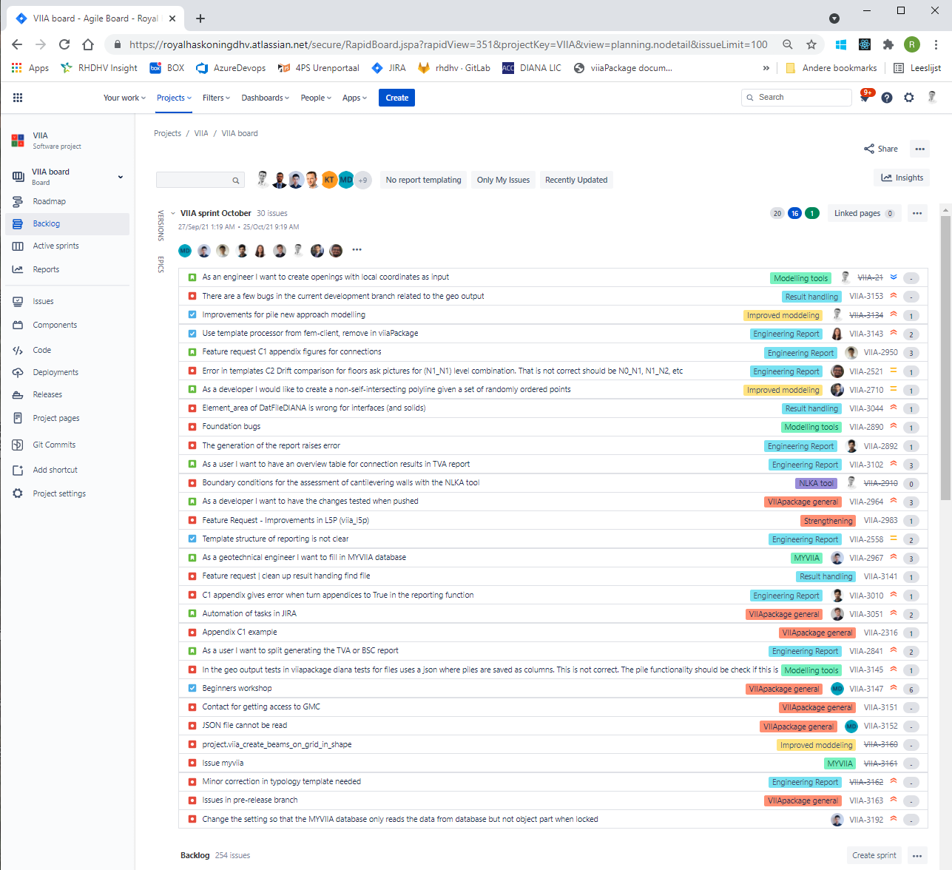
The VIIA team – Engineering
Team
Technical master
Task force
Automating team
Tender
Knowledge team

Slide 23
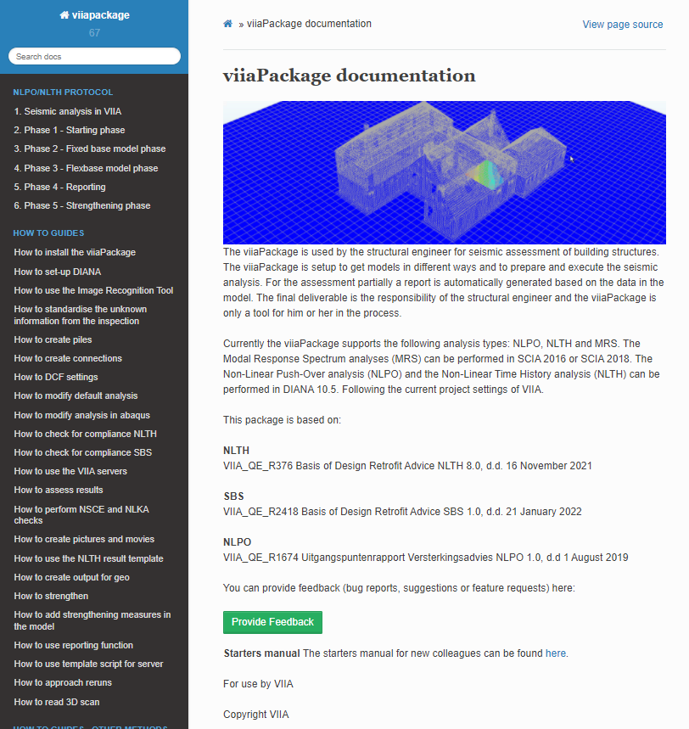
Reporting bugs / issue report
The issue report should provide:
name (without we cannot contact user and ask specifics),
scripts to reproduce the error (mainscript and model-json or modelscript) (if we can’t reproduce the error we will not be able to check if issue is solved),
clear description of the error encountered and why that is an error (sometimes we get remarks like the piles don’t work…),
clear description of the requirements of the solution (code-snippet if you solved the issue yourself),
environment: version of the fem-client and the version of the viiaPackage (including last date of updating the branch, or better the branch hash),
explanation of the attempts that have been undertaken to solve the issue.

Slide 24
Flexbase analyses – Supports
Protocol
Creation of flexbase supports
'MATERI' 1 NAME USRDEF_940M_100% DSNZ 4.15138E+08 DSSX 4.15138E+08 DSSY 4.15138E+08 RAYLEI 6.26231E-02 5.28754E-04 USRIFC COULOMB USRVAL 5.2100E-01 1.5000E+05 USRSTA 0.0 'END'
# ===================================================================================================================== # Flexbase model supports (step 9 protocol) # ===================================================================================================================== # Create flexbase supports if any analysis is selected after A4 if any(a not in ['A1', 'A2', 'A3', 'A4'] for a in analysis) and project.version == 1: # Shallow foundation interface for flex base # Select for FexBaseGlobal or FlexBaseFinal (provide file from geo-technical adviser) # Delete this part if there is no shallow foundation in the model project.viia_create_supports(support_type='FlexBaseGlobal', material_file='USRDEF_940M_100%.dat') # Example FlexBaseFinal # project.viia_create_supports( # support_type='FlexBaseFinal', # additional_supported_shapes=['N0-VLOEREN-LIN-BETON-150-1'], # material_dictionary={ # 'USRDEF_XXXX_100%.dat': [fstrip for fstrip in project.collections.fstrips], # 'USRDEF_XXXX_100%_floor.dat': ['N0-VLOEREN-LIN-BETON-150-1']})

Slide 25
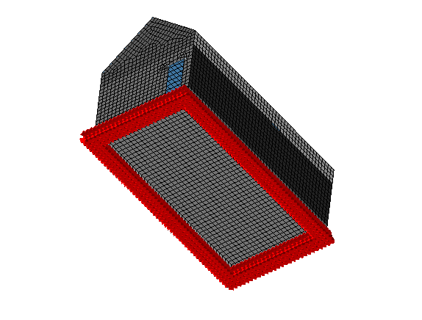
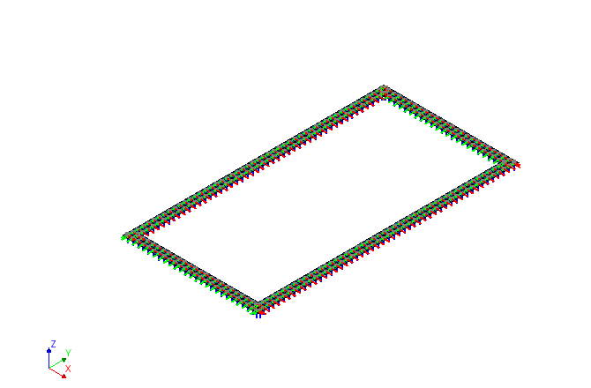
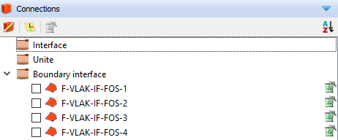
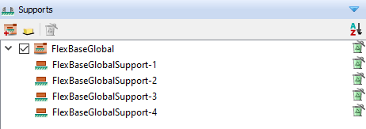
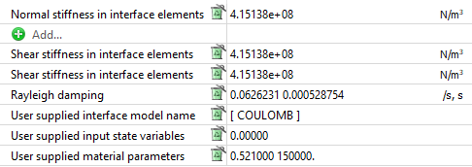
Flexbase analyses – Supports
Protocol
Combination of Fixed support and interface (shallow foundation)/spring (pile foundation)

Slide 26
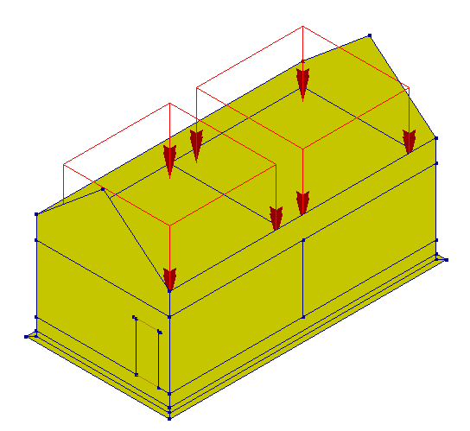
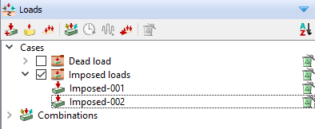
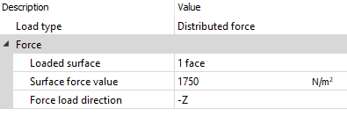
Flexbase analyses – Loads
Protocol
Eigenfrequency analysis (A7)
Non-linear static analysis (A10)
# Eigenvalue analysis flexbase (step A7 protocol) if 'A7' in analysis: project.viia_analysis(analysis_nr='A7', run=run_analysis, nmodes=num_modes)
Protocol
# Nonlinear static flexbase analysis (step A10) if 'A10' in analysis: # Convert imposed loads to self weight (as extra density), imposed loads are created in modelscript project.viia_convert_self_weight_to_imposed_loads() project.viia_analysis(analysis_nr='A10', run=run_analysis) project.viia_convert_imposed_loads_to_self_weight() warnings.warn(f"Imposed Loads have been converted to self weight. If not running analysis directly " f"(i.e. 'run_analysis' is set to False), then analysis is incorrect. Close DIANA and open A10 from " f"{project.diana_settings.current_analysis_folder}")

Slide 27
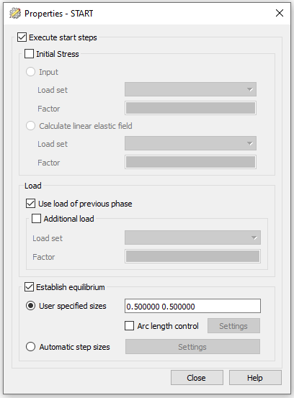
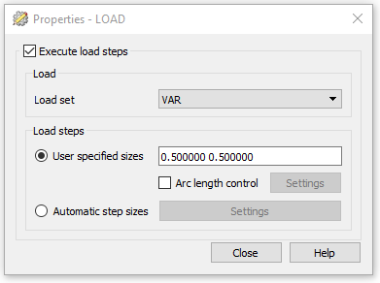
Flexbase analyses – Loads

Slide 28
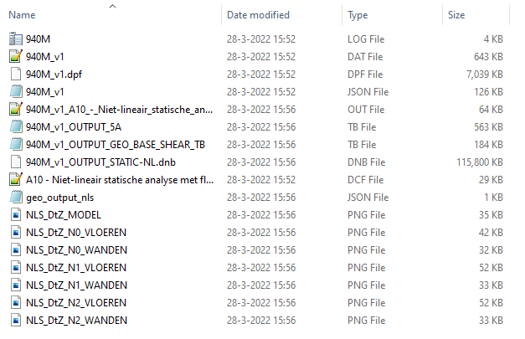
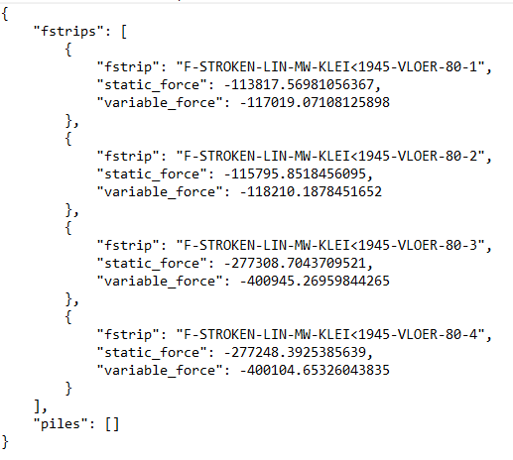
Flexbase analyses – NLS results
Result pictures
Geo Output
Protocol

Slide 29
Flexbase analyses – Loads
Non-linear Time History analyses (A12)
Protocol
In A10:
# Nonlinear time history flexbase analysis (step A12) if 'A12' in analysis: project.viia_create_loads('Base motion') project.viia_add_basemotion_signals() project.viia_create_loadcombination_base_motion(signal[0]) project.viia_create_datfile() project.viia_analysis(analysis_nr='A12', run=run_analysis, signals=signal)
In A12:

Slide 30
Flexbase analyses – Exercise 6
Create the A12 analysis for the workshop model in DIANA for signal S3.
Bonus:
Change the iteration method to ‘secant’ through the viiaPackage.

Slide 31
23 March 2022

Slide 32
Flexbase analyses - Result handling
Protocol
Convergence graph
Base shear
Out-of-plane displacements
Result pictures
Acceleration graphs
Geo Output

Slide 33
Flexbase analyses - Result handling (2)

Slide 34
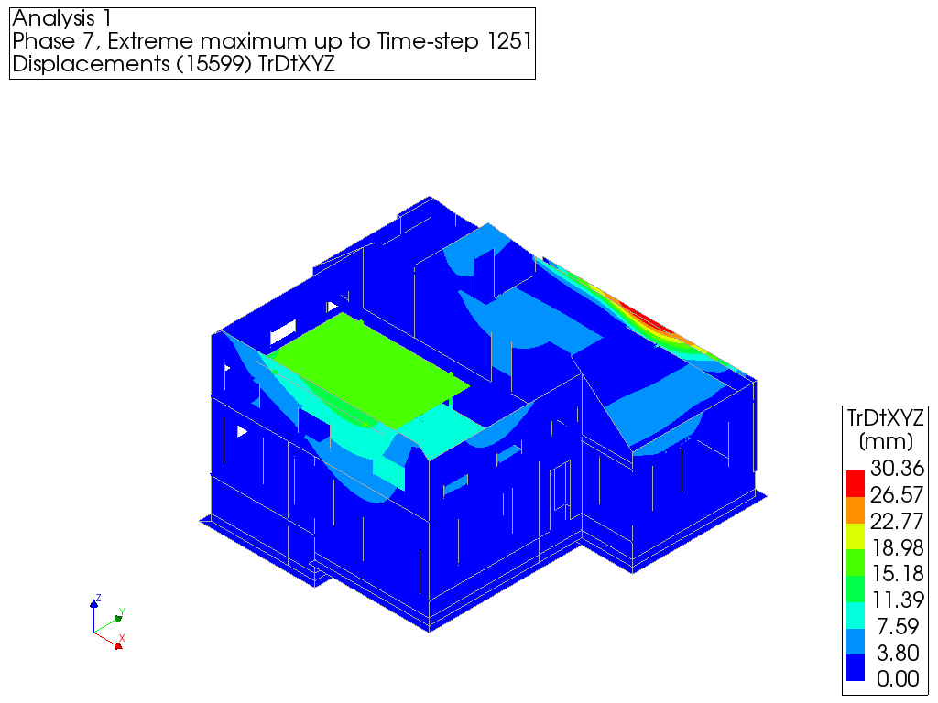
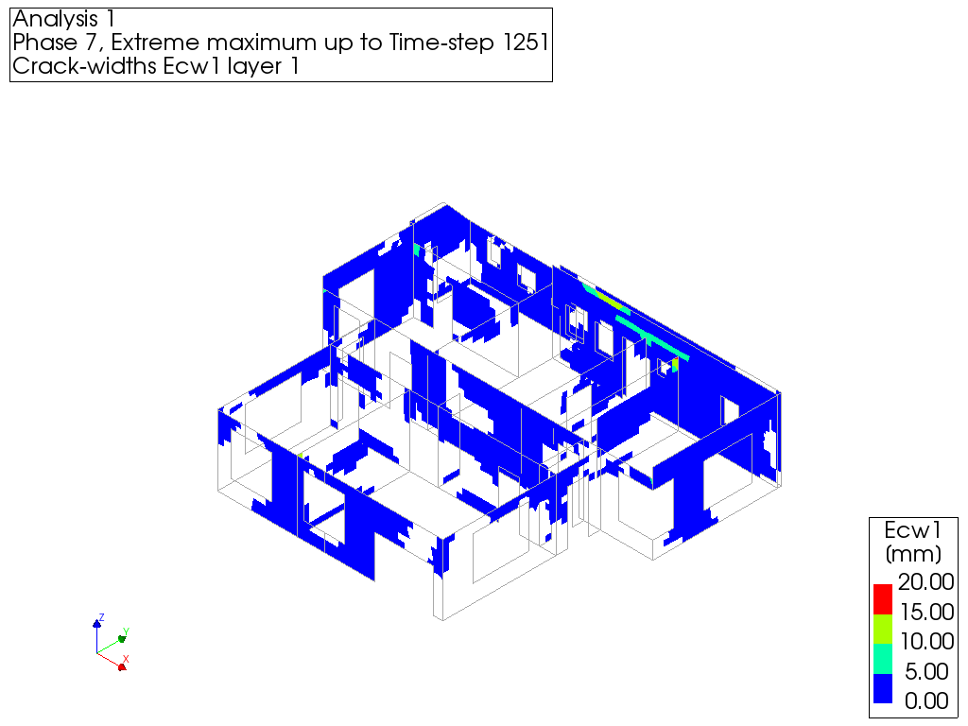
Flexbase analyses - Result handling (3)

Slide 35
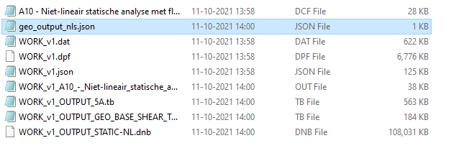
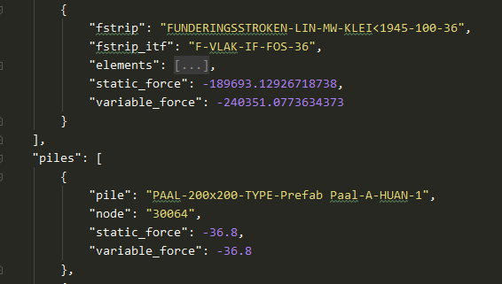
Flexbase analyses - Result handling GeoOutput NLS
Protocol
When running A10 analysis, set ‘run_analysis’ to True. geo_output_ nls is automatically created in analysis folder.
Alternatively, this can be manually created

Slide 36
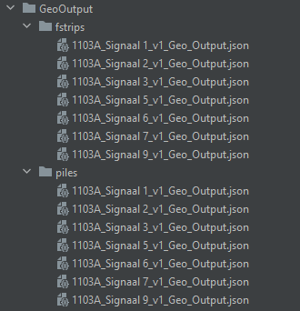
Flexbase analyses - Result handling GeoOutput NLTH
Protocol
Through the result script
Specify signal (str), geo_output (bool), bsc_nls_dir(Path) and tva_nls_dir (Path)

Slide 37
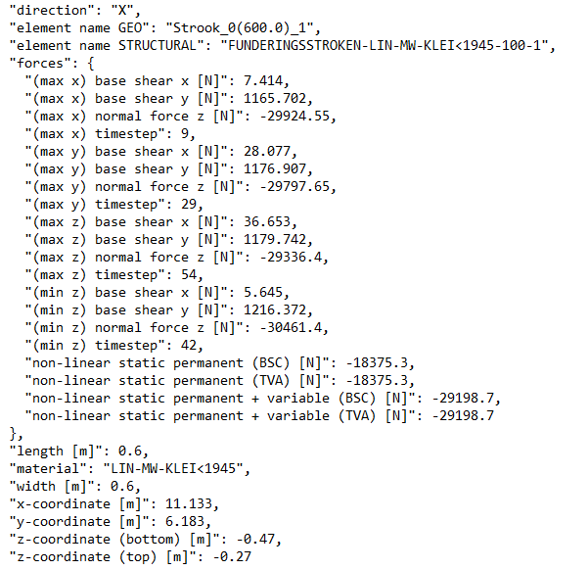
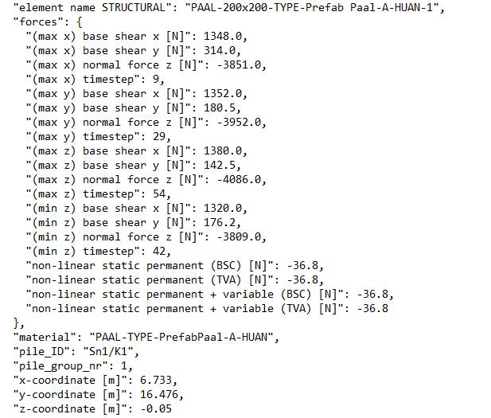
Flexbase analyses - Result handling GeoOutput

Slide 38
Strengthening
Protocol
Existing analyses shows deficiencies (BSC report)
Select measures -> maatregelen overleg
GMC
Cost engineer
Add measures in model and analyse
Update version number
Measures in MYVIIA

Slide 39
Strengthening – Result handling GeoOutput
No Strengthening - A10 for NLS and A12 for NLTH (version number: 1)
With Strengthening – A13 for NLS and A15 for NLTH (version number: 2)
In case strengthening is applied with no significant change in mass, specify tva_nls_dir same as bsc_nls_dir

Slide 40
Reporting
Protocol
BSC
Beoordeling Seismische Capaciteit
TVA
Technisch VersterkingsAdvies

Slide 41
Reporting
Protocol
Requirements for viia_create_report() for NLTH
General information is retrieved from MYVIIA
Analyses folders (including images) for:
A7 – Eigenvalue flex base
A10 – NLS flex base
A12 – NLTH flex base
Manual replacement of images is possible -> partly work in progress

Slide 42
Thanks, we hope you enjoyed this workshop!

