Slide 1
viiaPackage basics
Workshop – Day 1
Marijn Drillenburg and Reinier Ringers
March 23rd & 30th 2022
Internal use only

Slide 2
Contents of the workshop
Setup viiaPackage
Python environments
Modelscript vs mainscript
The project variable
Python basics in viiaPackage
Objects
Modelling basics
Gridlines
Draft model
Edit geometry
Cavity walls
Lintels
Shallow foundations
Loads
Dead loads
Imposed loads
Overview
23 March 2022

Slide 3
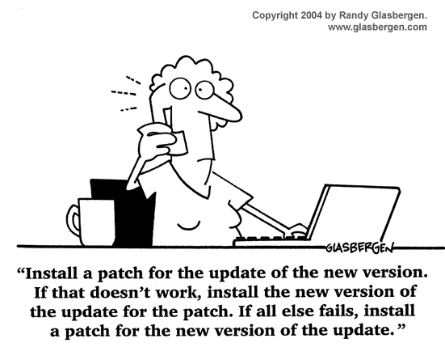
Setup viiaPackage
Protocol
Workfolder
Virtual environment
viiaPackage
FEM-client for DataFusr
User config file
23 March 2022

Slide 4
ModelScript start
Protocol
Use the viiaPackage by importing it
Create the project variable
Compare analysis data to MYVIIA (analysis type, NPR version etc.)
Versions: Existing situation is version nr. 1, strengthening >1
You can change parameters analysis_type or reference_period, but you will not be able to use the reporting functions. Inform the projectleader to modify MYVIIA if required.
from viiapackage import *
project = viia_create_project(project_name='940M')
23 March 2022

Slide 5
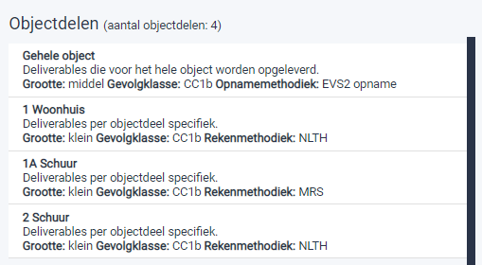
ModelScript start
Scope with different objectparts
Specify the objectpart in input argument (use exact name)
project = viia_create_project(project_name='1084A', object_part='1 Woonhuis')
23 March 2022

Slide 6
Live demo
23 March 2022

Slide 7
Setup environment – Exercise 1
Protocol
MYVIIA
Prepare an environment for this workshop.
Create folder for workshop
Copy startup script to the workshop folder and run.
Pause when asked for DIANA
Select object ‘940M’
Test if viiaPackage was installed properly.
23 March 2022

Slide 8
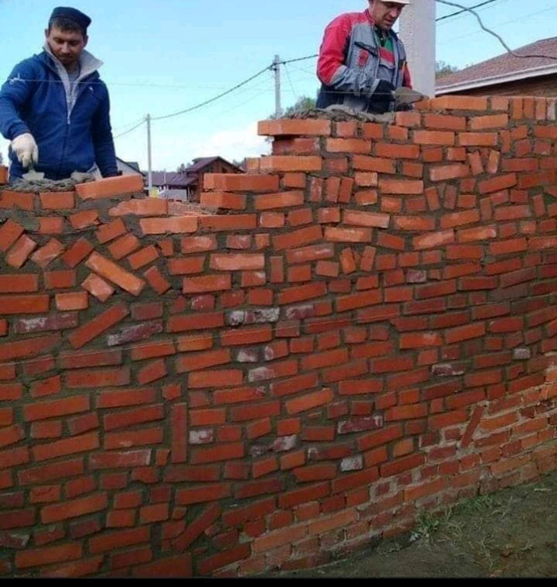
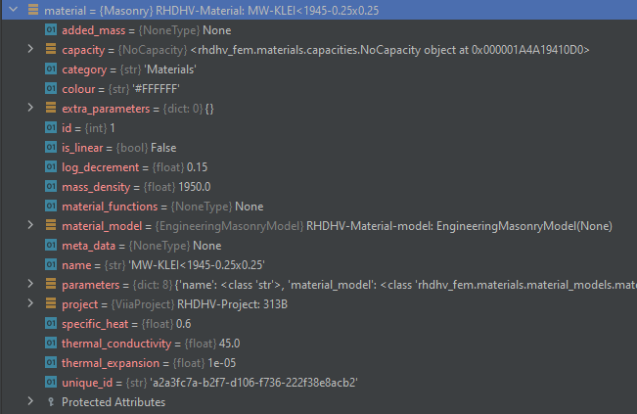
Modelling basics - Objects
Checkout how material info is stored.
Refer for names of materials to UPR.
23 March 2022

Slide 9
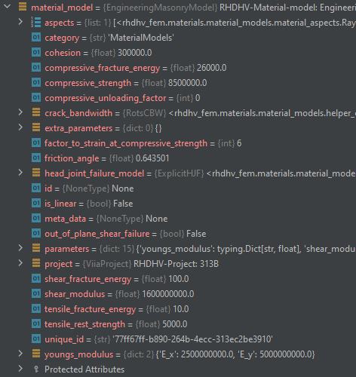
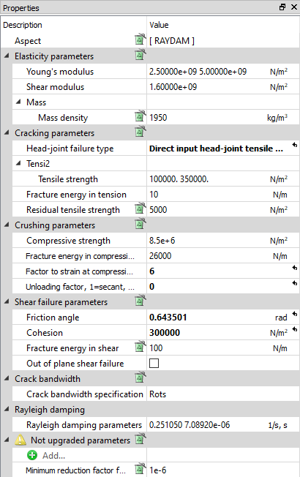
Modelling basics - Objects
Material model defines the structural model for the behaviour of the material.
Switch between linear and non-linear modelled material -> Replace the material model
You can get and set all attributes in python (be aware most parameters are VIIA defaults)
23 March 2022

Slide 10
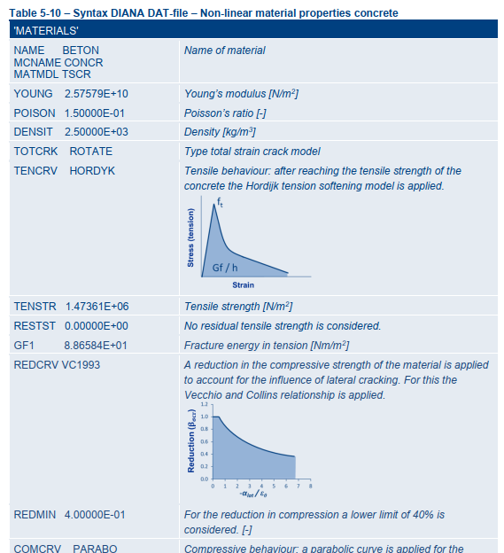
Modelling basics – Exercise 2
Create concrete for VIIA analyses
Create the material ‘BETON’
Reduce the density to 2200 kg/m3
Create linear concrete
Create the material
Reduce the stiffness to 50%
Bonus:
Create a rectangular profile-geometry object (300x600, bxh) using the material object you have just created.
Create geometry of 0.1m for floor.
23 March 2022

Slide 11
23 March 2022

Slide 12
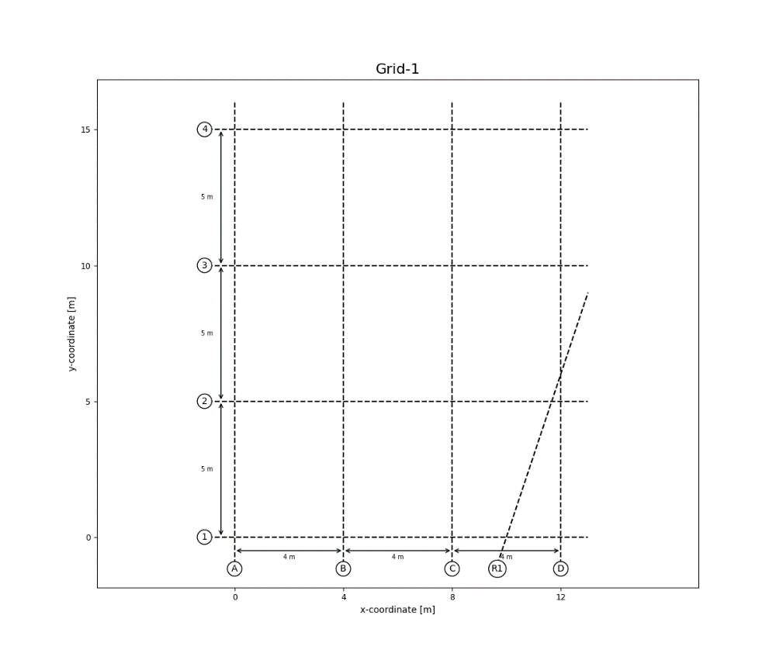
Modelling basics - Gridlines
Protocol
Convert inspection data to structural schematisation
List unknowns and discuss with lead engineer
23 March 2022

Slide 13
Modelling basics - Gridlines
Protocol
Determine grid and levels (better not adjust later)
Create the gridlines
Check your grid by plotting it (simple plots only for verification of input)
x_grid = [0, 4.4, 6.7, 9.4, 12.1, 15.8, 17.9, 35.1] y_grid = [0, 1.3, 2.1, 3.7, 4.9, 8.1, 11.4, 16.4] grid = project.viia_create_orthogonal_grid([[x_grid, y_grid]], name='Main Grid')
grid.plot()
23 March 2022

Slide 14
Modelling basics – Draft model
Protocol
Add walls per layer (<< B2 - B1 - N0 - N1 - N2 - N3 >>)
Add floors, check spans (especially for timber floors with joist and planks)
Check by plotting
# Walls n0_wall_list = [ ['A1', 'B1', 'MW-KLEI<1945', 100], ['A2', 'B2', 'MW-KLEI<1945', 100], ['A1', 'A2', 'MW-KLEI<1945', 100], ['B1', 'B2', 'MW-KLEI<1945', 100]] project.viia_create_walls_on_grid(layer='N0', z_bottom=grid['L1'], z_top=grid['L2'], wall_list=n0_wall_list)
# Floors n0_floor_list = [ ['A1', 'B1', 'B2', 'A2', 'LIN-HBV-PLANKEN-0.018-0.07-0.17-0.6', 188]] project.viia_create_floors_on_grid(layer='N0', z_coordinate=grid['L1'], floor_list=n0_floor_list)
# Plot layer in 3D project.viia_plot_layers(layers='N0', view='3D')
23 March 2022

Slide 15
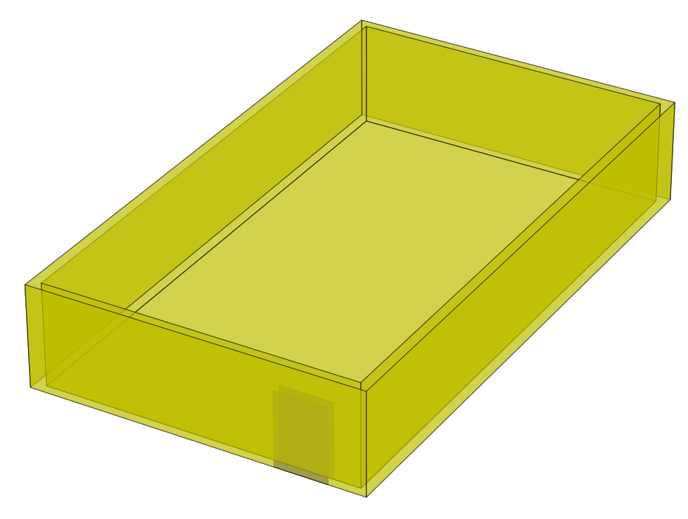
Modelling basics – Cavity walls
Protocol
Cavity walls with/without wall ties
project.viia_create_cavity_wall_ties_from_list(['wall_1', 'wall_2', 'wall_3', 'wall_4'], cavity=0.1, wall_tie_distance=0.775)
This function implements:
viia_create_outer_leaf
viia_create_cavity_wall_ties
viia_connect_cavity_walls
viia_create_dummy_plate_between_walls
docstring
23 March 2022

Slide 16
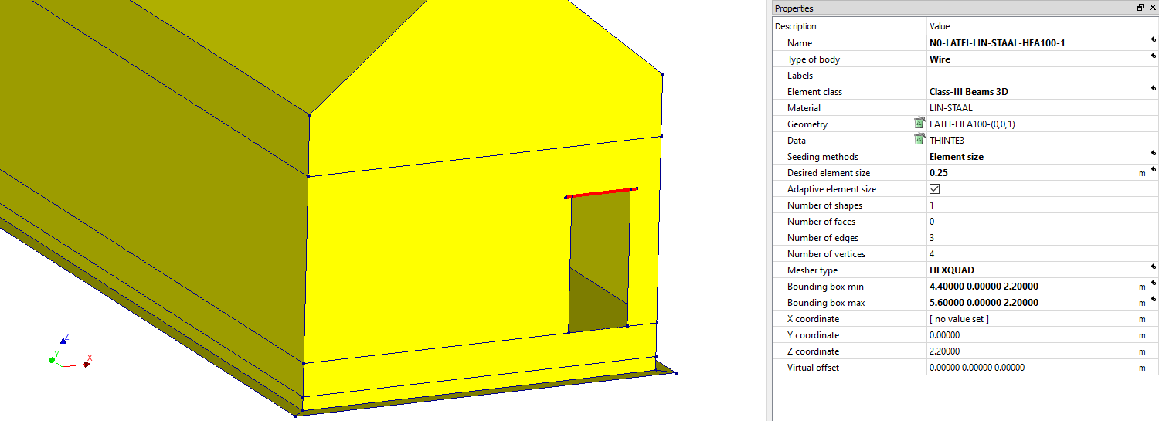
Modelling basics – Openings & Lintels
Protocol
Auto generate lintels
project.viia_create_all_lintels(lintel_material='LIN-STAAL', lintel_type='HEA100', collection='N0')
23 March 2022

Slide 17
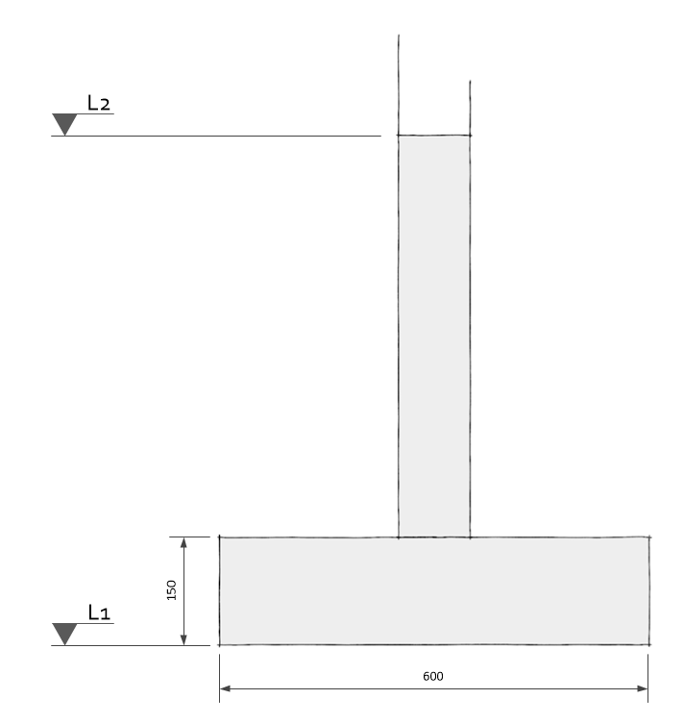
Modelling basics – Foundations
Protocol
Concrete strip foundation
Input: walls underneath which the foundation will be applied
Foundation depth: Bottom side of the foundation, where the actual support is
project.viia_create_foundation_walls_and_strips( walls=walls_for_foundation, strip_material='LIN-MW-KLEI<1945', strip_width=600, strip_thickness=150, foundation_depth=grid['L1'])
23 March 2022

Slide 18
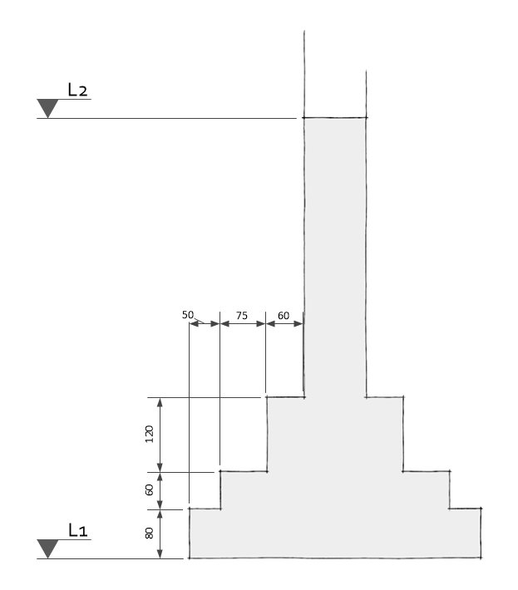
Modelling basics – Foundations
Protocol
Stepped foundation
Input: walls underneath which the foundation will be applied.
Foundation depth: Bottom side of the foundation, where the actual support is.
You can check the calculated properties with the excel sheet in rekentools (link)
Nonlinear masonry
Linear masonry, equivalent thickness and density
project.viia_create_foundation_walls_and_strips( walls=walls_for_foundation, strip_material='LIN-MW-KLEI<1945', stepped_foundation_strip_extensions=[60, 75, 50], stepped_foundation_strip_heights=[120, 60, 80], foundation_depth=grid['L1'])
Linear masonry, real width, normal density
23 March 2022

Slide 19
Modelling basics – Exercise 3
Create basic model
Create the grid
Create the shapes: floors, walls, roofs
Create some openings
Create lintels
Create the foundation
Create appendix C1 of the structure
Bonus:
Load in DIANA / ABAQUS
23 March 2022

Slide 20
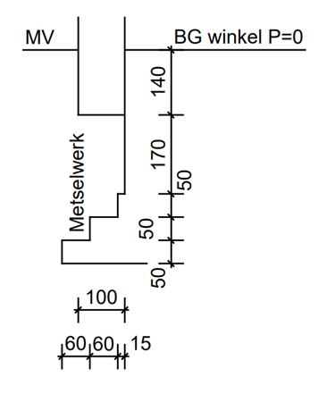
Modelling basics – Exercise 3
Stepped footing
Concrete strip
3.5 m
Walls: MW-KLEI<1945
Floors: LIN-HBV-PLANKEN-0.018-0.05-0.2-0.6
Roofs: LIN-HBV-PLATEN-0.018-0.05-0.2-0.6
6.0 m
1.0 m
3.0 m
6.0 m
0.8 m
6.0 m
23 March 2022

Slide 21
23 March 2022

Slide 22
Loads – Dead loads
Protocol
Create self weight loadcase
Create resting loads
project.viia_create_loads('Self weight')
Resting loads in viiaPackage
WindowLoad
FinishLoad
CeilingLoad
WallLoad
WallLoadLight
WallLoadMedium
WallLoadHeavy
InstalLoad
FlattRoofLoad
SlopeRoofLoad
SlopeRoofLoadConcrete
SlopeRoofLoadClay
SunPanelLoad
# Loads on sloped roofs for roof in [roof_1, roof_2]: project.viia_create_surface_mass_floor(floor=roof, resting_load=['SlopeRoofLoad'])
23 March 2022

Slide 23
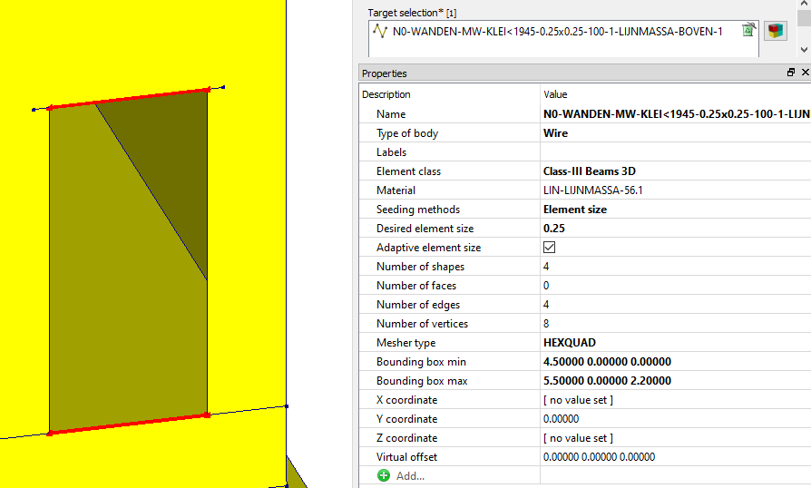
Loads – Dead loads
Protocol
Create resting loads in openings
Applies opening load of 0.5 kN/m² on openings in walls and roofs
Half the load will be applied on bottom and half on top of the opening
Applied as mass:
Class III Beam 3D, 0.1m x 0.1m
2.2m x 0.5 x 500 N/m² / 9.1 m/s² = 56.1 kg/m
56.1 kg/m / 0.01m² = 5610 kg/m³
project.viia_create_mass_all_openings()
2.2m
23 March 2022

Slide 24
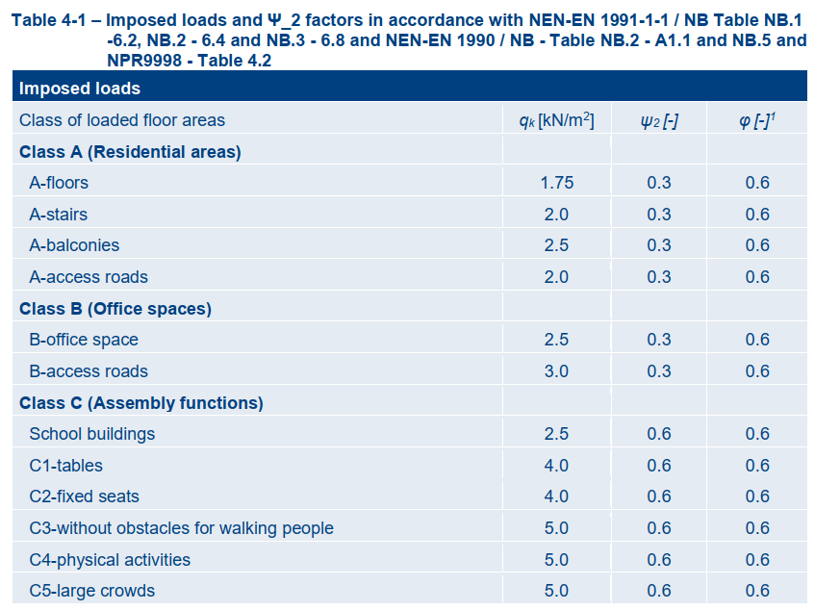
Loads – Imposed loads
Protocol
Create imposed loads on floors
Imposed loads are created as load (reduction factors not applied yet)
project.viia_create_loads(load='Imposed load', category='AFloor', connecting_shapes=project.collections.floors)
23 March 2022

Slide 25
Modelling basics – Exercise 4
Create loads for residential usage
Create json-model
Bonus:
Apply load for the solar panels on part of the roof
23 March 2022

Slide 26
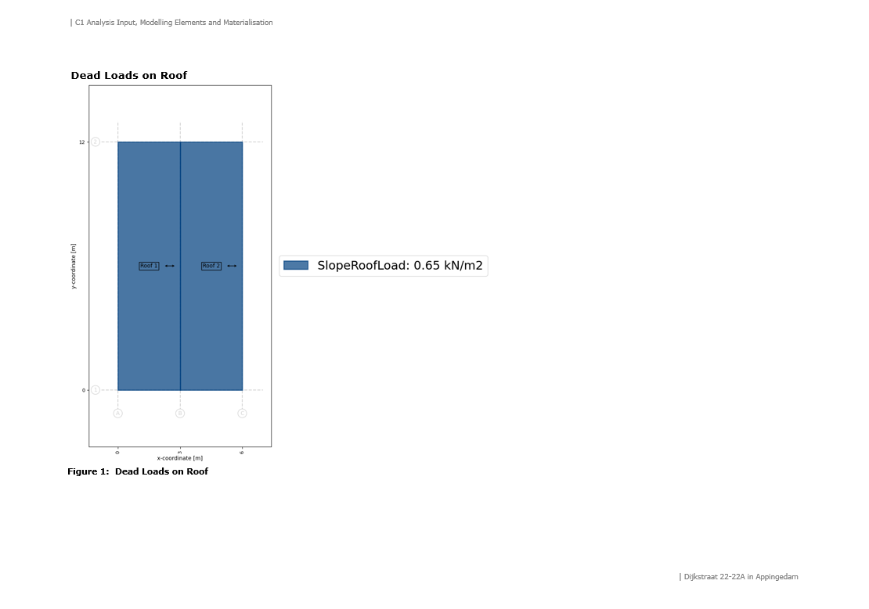
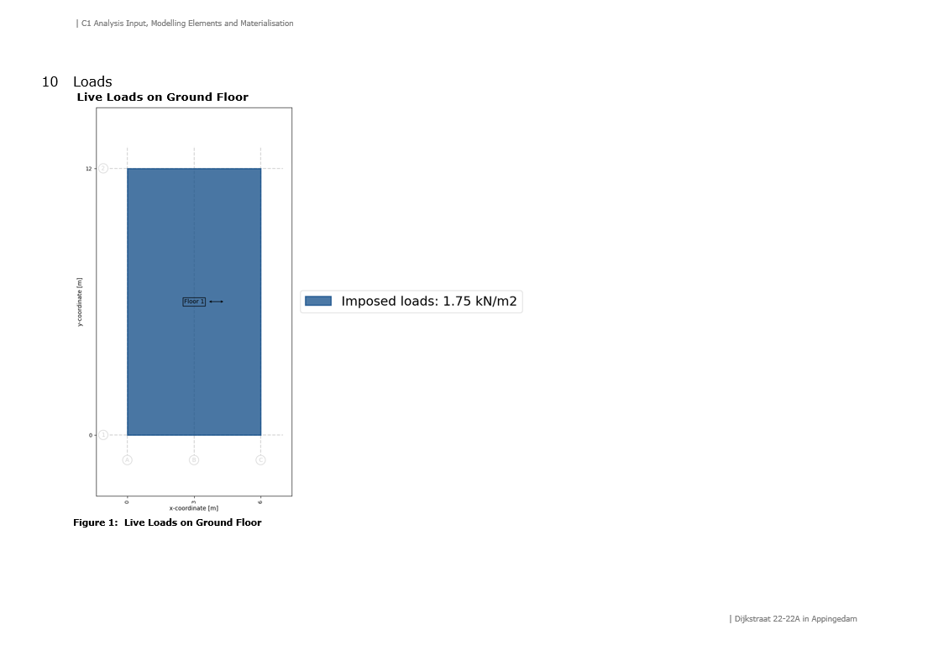
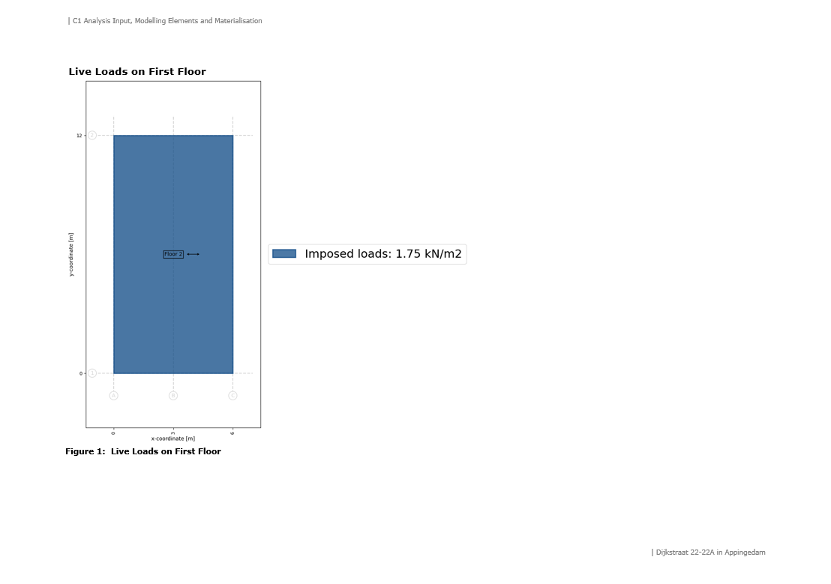
Loads – Overview
Protocol
Do not create loadcombinations in modelscript
Generate appendix C1, including loading schemas
project.viia_create_appendix_c1_pictures()
project.viia_create_appendix_c1()
23 March 2022

Slide 27
See you next week!
23 March 2022

