Slide 1
viiaPackage basics
Workshop – Day 1
Marijn Drillenburg, Jurriaan Floor, Carolina Fonseca and Reinier Ringers
June 28th, 2023
Internal use only

Slide 2
Contents of the workshop
Setup viiaPackage
Installation summary
Templates within the workfolder
Modelling basics
Gridlines
Draft model
Edit geometry
Cavity walls
Openings
Lintels
Shallow foundations
How material info is stored
Loads
Dead loads
Imposed loads
Output files from modelscript
Json
Pictures
28 June 2023

Slide 3
Set Up the VIIA Package
28 June 2023

Slide 4
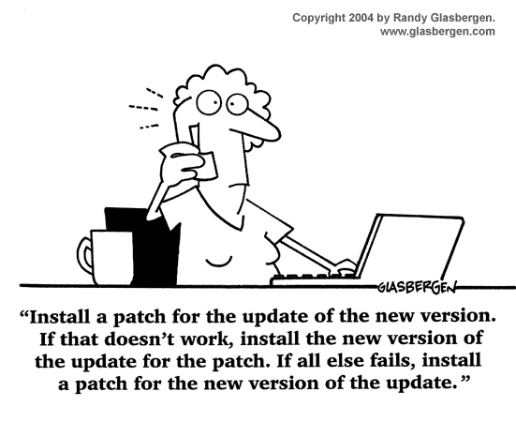
Installation summary
Workfolder
Create a workfolder where the viiapackage will be installed. Note: the model files and the FEM assessments will be prepared and stored in this folder!
Installation of the viiapackage
Download the setup files (protocol) and save them in the workfolder
Run the setup files as admin → virtual env. with:
VIIA package
FEM-client for DataFusr
All other requirements and packages
Packages are also installed in DIANA
Complete instructions can be found in the protocol
28 June 2023

Slide 5
Scripts within the workfolder
Modelscript
Mainscript
Resultscript
User_config
To create and assign geometries, materials and non-seismic loads.
To create the support conditions, base motions, load combinations and connections.
To create the analyses
Creates result pictures, graphs, geo output, etc.
File with myviia credentials
28 June 2023

Slide 6
Scripts within the workfolder
Modelscript
Mainscript
Resultscript
User_config
To create and assign geometries, materials and non-seismic loads.
To create the support conditions, base motions, load combinations and connections.
To create the analyses
Creates result pictures, graphs, geo output, etc.
File with myviia credentials
28 June 2023

Slide 7
Starting with the Modelscript
Protocol
The viiaPackage is imported
If needed the fem package and other functions can be imported
from viiapackage import *
import rhdhv_fem
from rhdhv_fem import fem_math
28 June 2023

Slide 8
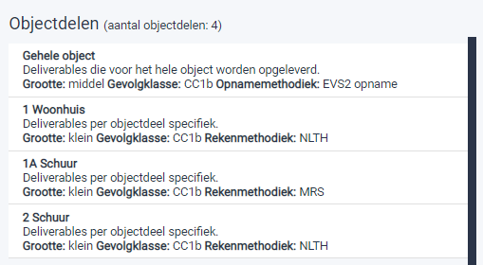
Starting with the Modelscript
Create the project variable:
project = viia_create_project(project_name='1416T’, version_nr=1, object_part='Gehele object')
Object part
Versions
Existing situation → version_nr: 1, strengthening → version_nr > 1
analysis_type or reference_period can be changed but you will not be able to use the reporting functions.
Important! Compare analysis data to MYVIIA (analysis type, NPR version, etc.)
Inform the project leader to modify MYVIIA if required.
28 June 2023

Slide 9
Setup environment – Exercise 1
Protocol
MYVIIA
Prepare an environment for this workshop.
Create folder for workshop
Install on DIANA.
Select object ‘940M’
Test if viiaPackage was installed properly.
MYVIIA_SERVER_URL = 'https://viiadevbackend.azurewebsites.net'
Login name: workshopX@viiagroningen.nl
https://viiadevfrontend.z6.web.core.windows.net/index.html
28 June 2023

Slide 10
28 June 2023

Slide 11
Modelling Basics
28 June 2023

Slide 12
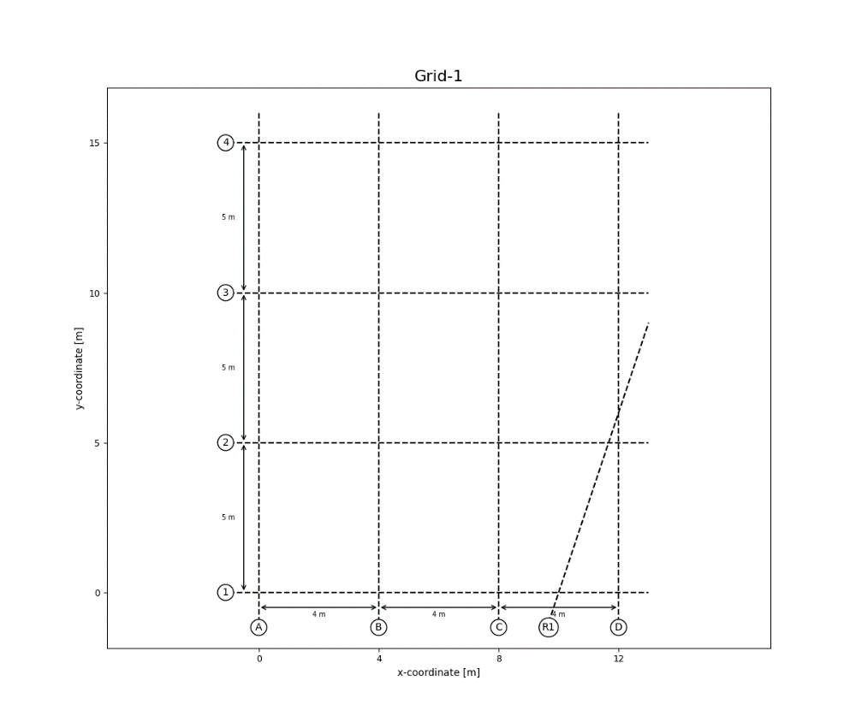
Gridlines
Protocol
Convert inspection data to structural schematisation
List unknowns and discuss with lead engineer
28 June 2023

Slide 13
Gridlines
Protocol
Determine grid and levels (better not adjust later)
Create the gridlines
Check your grid by plotting it (simple plots only for verification of input)
You can create as many grids as needed. Note that the first grid is the default!
x_grid = [0, 4.4, 6.7, 9.4, 12.1, 15.8, 17.9, 35.1] y_grid = [0, 1.3, 2.1, 3.7, 4.9, 8.1, 11.4, 16.4] grid = project.viia_create_orthogonal_grid([[x_grid, y_grid]], name='Main Grid')
grid.plot()
# Create grid --> ground floor walls grid_bg = project.viia_create_orthogonal_grid([[0, 8.0, 11.75, 12.55, 15.50, 18.55, 21.90], [0, 4.80, 7.35, 8.45, 11.30]], name='Ground floor') # Create grid --> first floor walls grid_f1 = project.viia_create_orthogonal_grid([[0, 10.40, 15.50, 18.55], [0, 2.35, 7.35, 8.90, 11.30]], name='First floor') # Create grid --> second floor walls grid_f2 = project.viia_create_orthogonal_grid([[0, 3.60, 10.40, 14.50, 15.50], [0, 2.45, 8.80, 11.30]], name='Second floor') # Create grid --> roof grid_rafters = project.viia_create_orthogonal_grid([[2.15, 3.8, 6.1, 7.75, 8.9, 10, 11.2], [0, 2.45, 5.65, 8.80, 11.30]], name='Rafters')
28 June 2023

Slide 14
Draft model
Protocol
Add walls per layer (<< B2 - B1 - N0 - N1 - N2 - N3 >>) → think of the layers as the phases in which the building would be constructed
Add floors & roofs → check spans (especially for elements with joist and planks)
Check by plotting
# Walls n0_wall_list = [ ['A1', 'B1', 'MW-KLEI<1945', 100], ['A2', 'B2', 'MW-KLEI<1945', 100], ['A1', 'A2', 'MW-KLEI<1945', 100], ['B1', 'B2', 'MW-KLEI<1945', 100]] project.viia_create_walls_on_grid(layer='N0', z_bottom=grid['L1'], z_top=grid['L2'], wall_list=n0_wall_list)
# Floors n0_floor_list = [ ['A1', 'B1', 'B2', 'A2', 'LIN-HBV-PLANKEN-0.018-0.07-0.17-0.6’, 0]] project.viia_create_floors_on_grid(layer='N0', z_coordinate=grid['L1'], floor_list=n0_floor_list)
# Plot layer in 3D project.viia_plot_layers(layers='N0', view='3D')
28 June 2023

Slide 15
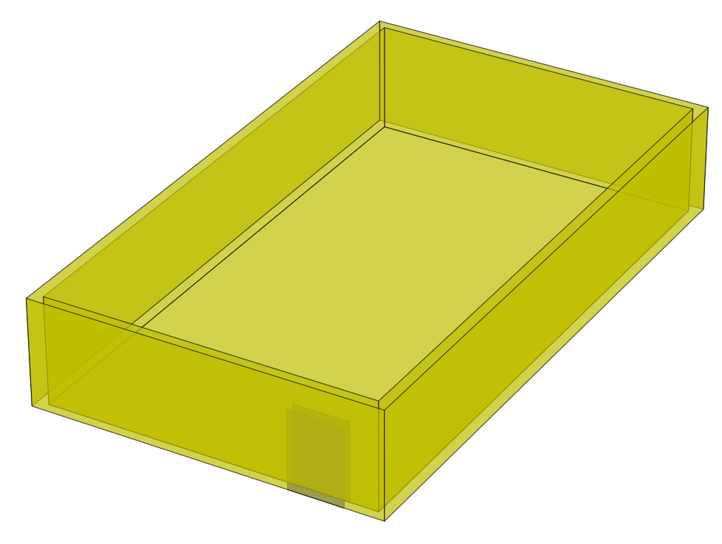
Cavity walls
Protocol
Cavity walls with/without wall ties
project.viia_create_cavity_wall_ties_from_list(['wall_1', 'wall_2', 'wall_3', 'wall_4'], cavity=0.1, wall_tie_distance=0.775)
This function implements:
viia_create_outer_leaf
viia_create_cavity_wall_ties
viia_connect_cavity_walls
viia_create_dummy_plate_between_walls
docstring
28 June 2023

Slide 16
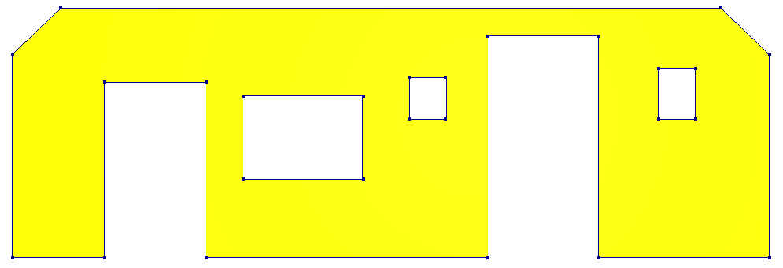
Openings
Wall openings:
n0_wall_opening_list = [ ['wall_5', [[0.55, 2.45, 0, 2.5]]], ['wall_15', [[2.5, 0.65, 0.85, 1.15], [0.65, 0.65, 0.85, 1.15]]] ] project.viia_add_openings(opening_data_list=n0_wall_opening_list)
1. Distance from edge of wall to 1st opening OR distance from previous opening to the next
2. Width of the opening
3. Height from bottom of wall to opening
4. Height of the opening
1
1
2
4
3
28 June 2023

Slide 17
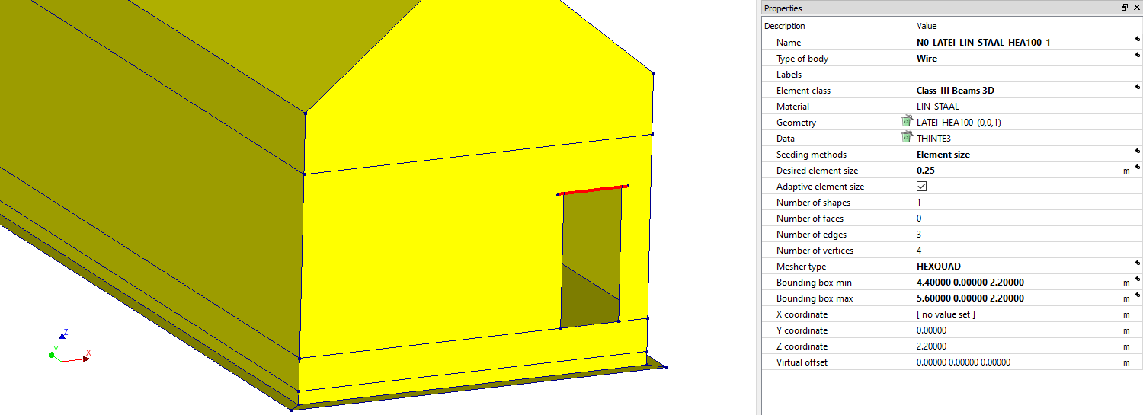
Lintels
Protocol
List of walls
‘All’ : all the walls in the model
Walls in a layer
Auto generate lintels
project.viia_create_all_lintels(lintel_material='LIN-STAAL', lintel_type='HEA100', collection='N0')
28 June 2023

Slide 18
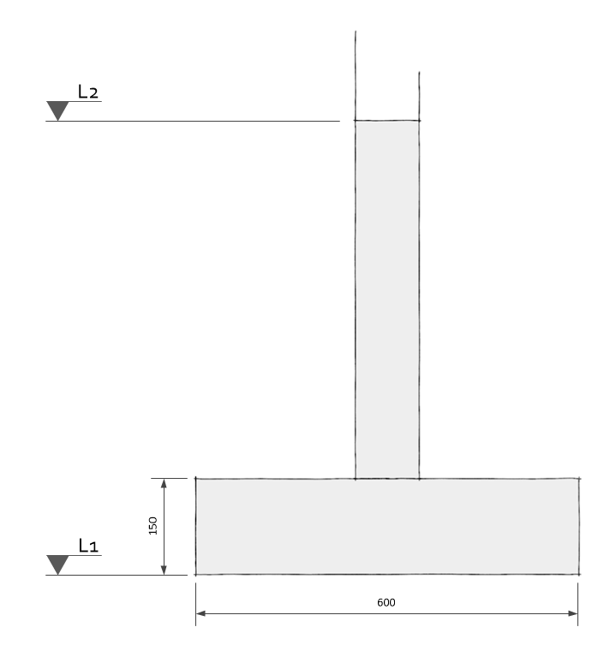
Foundations
Protocol
Concrete strip foundation
Input: walls underneath which the foundation will be applied
Foundation depth: Bottom side of the foundation, where the actual support is
project.viia_create_foundation_walls_and_strips( walls=walls_for_foundation, strip_material='LIN-MW-KLEI<1945', strip_width=600, strip_thickness=150, foundation_depth=grid['L1'])
28 June 2023

Slide 19
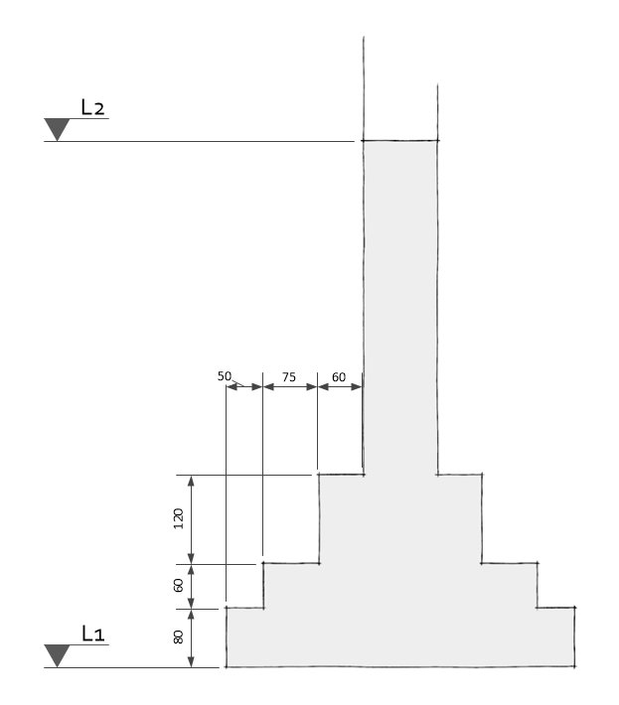
Foundations
Protocol
Stepped foundation
Input: walls underneath which the foundation will be applied.
Foundation depth: Bottom side of the foundation, where the actual support is.
You can check the calculated properties with the excel sheet in rekentools (link)
Nonlinear masonry
Linear masonry, equivalent thickness and density
project.viia_create_foundation_walls_and_strips( walls=walls_for_foundation, strip_material='LIN-MW-KLEI<1945', stepped_foundation_strip_extensions=[60, 75, 50], stepped_foundation_strip_heights=[120, 60, 80], foundation_depth=grid['L1'])
Linear masonry, real width, normal density
28 June 2023

Slide 20
Interactive modelling
project.viia_start_interactive_modelling( level=levels[2], layer='N0', grid_lines=grid_main, geometry_material_combinations=[[100, 'MW-KLEI<1945'], [210, 'MW-KZS>1960']], shape_type='wall', top_level=levels[3] )
Demo video
28 June 2023

Slide 21
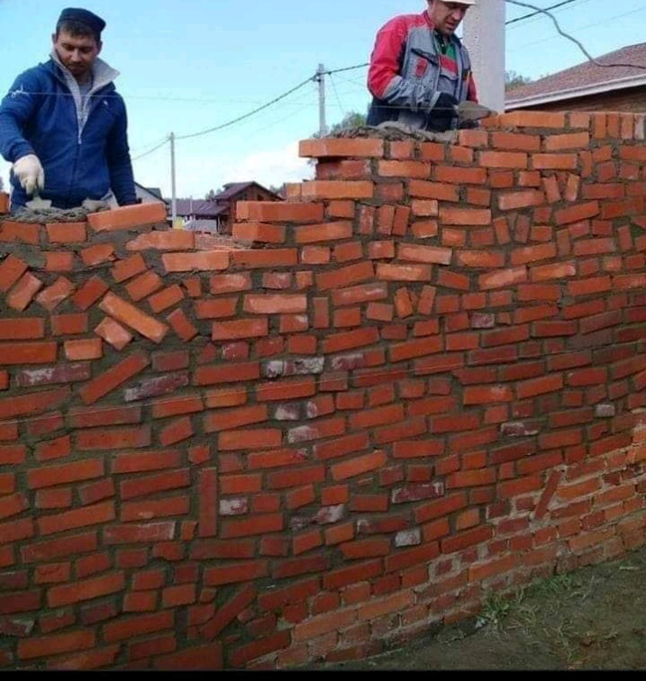
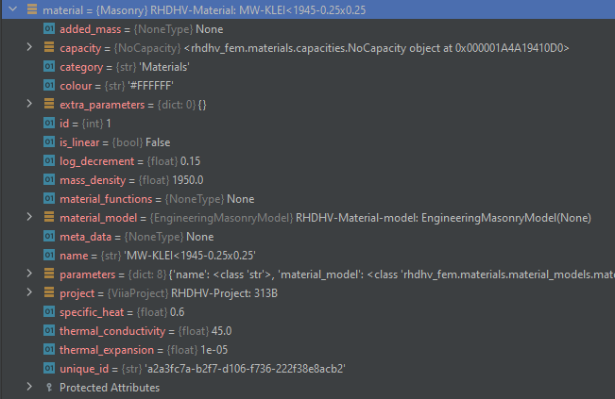
How material info is stored
Refer for names of materials to UPR.
28 June 2023

Slide 22
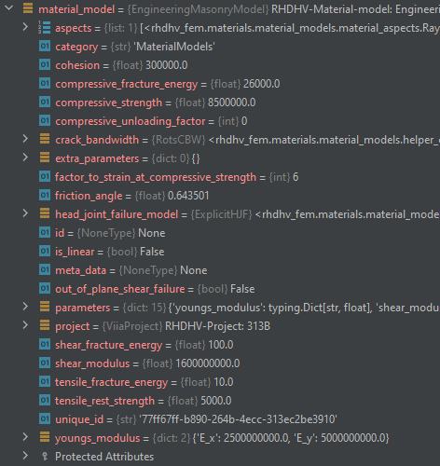
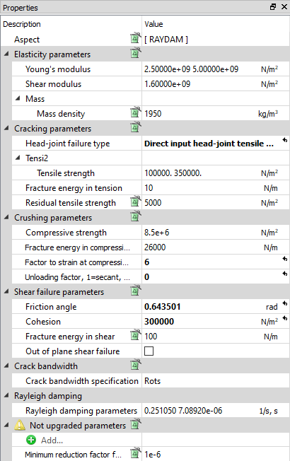
How material info is stored
Material model defines the structural model for the behaviour of the material.
Switch between linear and non-linear modelled material -> Replace the material model
You can get and set all attributes in python (be aware most parameters are VIIA defaults)
28 June 2023

Slide 23
Exercise 2
Create basic model
Create the grid
Create the shapes: floors, walls, roofs
Create some openings
Create lintels
Create the foundation
Create appendix C1 of the structure
Bonus:
Load in DIANA
28 June 2023

Slide 24
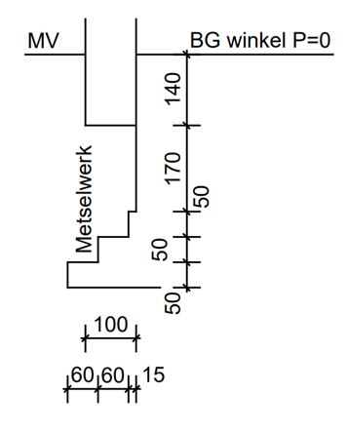
Exercise 2
Stepped footing
Concrete strip
3.5 m
Walls: MW-KLEI<1945
Floors: LIN-HBV-PLANKEN-0.018-0.05-0.2-0.6
Roofs: LIN-HBV-PLATEN-0.018-0.05-0.2-0.6
6.0 m
1.0 m
3.0 m
6.0 m
0.8 m
6.0 m
28 June 2023

Slide 25
28 June 2023

Slide 26
Loads
28 June 2023

Slide 27
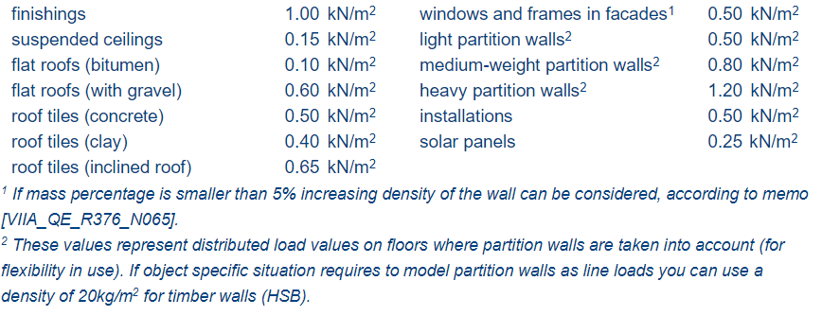
Dead loads
Protocol
Create self weight loadcase
Create resting loads
project.viia_create_loads('Self weight')
Resting loads in viiaPackage
WindowLoad
FinishLoad
CeilingLoad
WallLoad
WallLoadLight
WallLoadMedium
WallLoadHeavy
InstalLoad
FlatRoofLoad
FlatRoofGravelLoad
SlopeRoofLoad
SlopeRoofLoadConcrete
SlopeRoofLoadClay
SunPanelLoad
# Loads on sloped roofs for roof in [roof_1, roof_2]: project.viia_create_surface_mass_floor(floor=roof, resting_load=['SlopeRoofLoad'])
Section 4.1.3 of the UPR
28 June 2023

Slide 28
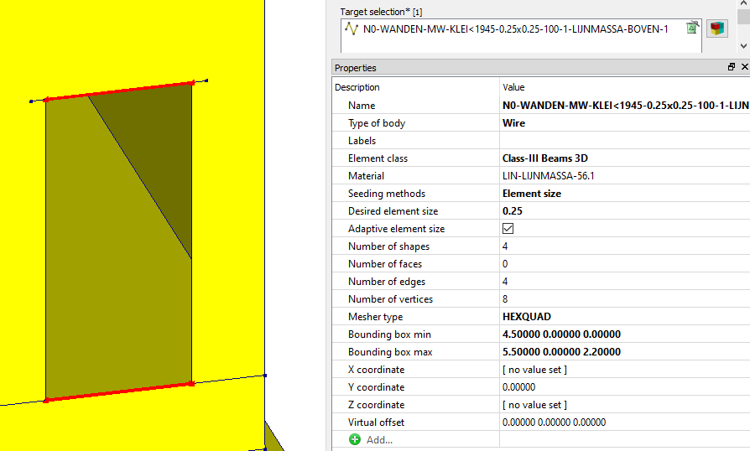
Dead loads
Protocol
Create resting loads in openings
Applies opening load of 0.5 kN/m² on openings in walls and roofs
Half the load will be applied on bottom and half on top of the opening
Applied as mass:
Class III Beam 3D, 0.1m x 0.1m
2.2m x 0.5 x 500 N/m² / 9.1 m/s² = 56.1 kg/m
56.1 kg/m / 0.01m² = 5610 kg/m³
project.viia_create_mass_all_openings()
2.2m
28 June 2023

Slide 29
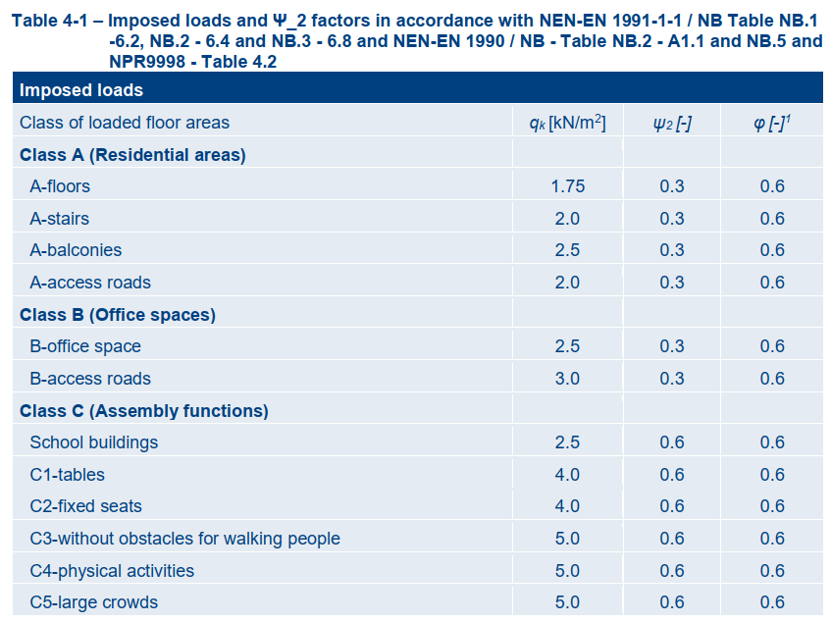
Imposed loads
Protocol
project.viia_create_loads(load='Imposed load', category='AFloor', connecting_shapes=project.collections.floors)
Create imposed loads on floors
Imposed loads are created as load (reduction factors not applied yet)
Imposed loads in the VIIA Package
'AFloor’
'AStairs’
‘ABalc’
'BOffice’
'CSchool’
'C1_2’
'C3_5’
'DShop’
'E’
‘F‘
’HRoof'
28 June 2023

Slide 30
Output files from modelscript
28 June 2023

Slide 31
End of modelscript
# Connect all shapes project.viia_connect_all_shapes() # Set data properties to all shapes project.viia_create_all_datas() # View model in matplot project.viia_create_plots() # Create json-file from model (stored in model sub-folder) project.viia_write_dump() # Create pictures for building structural setup appendix project.viia_create_model_plots() # Create the building structural setup appendix project.viia_create_model_plots_appendix() # Create the PSSE NSCE plot project.viia_plot_psse_nsce()
Merges nodes in lines in the object to connect all shapes
Assigns the data properties to the shapes
Creates a 3D interactive view of the model
Creates the model json* → this file contains all the model information and is read later by the mainscript
Creates pictures of the structure and applied loads and materials
Creates the C3 appendix
Creates pictures with NSCEs and PSSEs
28 June 2023

Slide 32
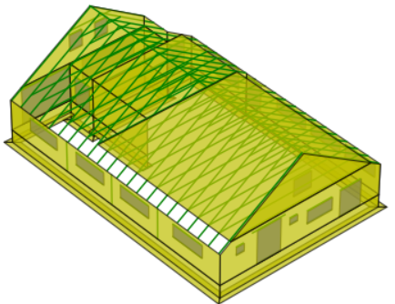
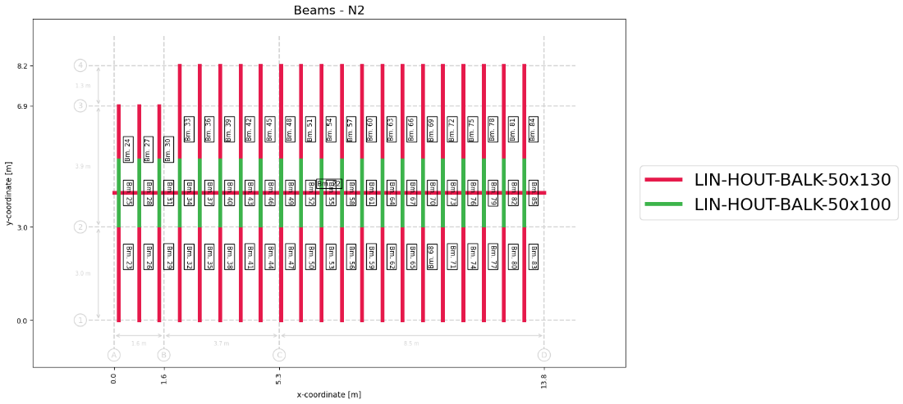
End of modelscript
28 June 2023

Slide 33
Exercise 3
Create loads for residential usage
Create json-model
Bonus:
Apply load for the solar panels on part of the roof
UPR 9.0
28 June 2023

