Slide 1

viiaPackage basics
Workshop – Day 2
Marijn Drillenburg, Carolina Fonseca and Reinier Ringers
June 29th, 2023
Internal use only

Slide 2

Contents of the workshop – Day 2
Fixed base analyses
  Loads and supports
  A1: Static analysis
  A2: Rob-test
  A3: Eigenvalue analysis
  A4: linear time-history analysis
Servers
The VIIA team
  The process of an object
  Team
  Bug reporting
Flexbase analyses
  Loads and supports
  A7: Eigenvalue analysis
  A10: Static non-linear analysis
  A12: Nonlinear time history analysis
  Result handling: Geo-output
Strengthening measures
Reporting
  BSC
  TVA
  Appendices
REF approach method
29 June 2023

Slide 3
Fixed base analyses
29 June 2023

Slide 4
Booleans mainscript
Analysis
Select analysis from A1, A2, A3, A4, A7, A10, A12, A13, A15.
Multiple inputs allowed.
Num_modes
Select the number of modes for A3 and/or A7.
Signal
Select analysis from S1, S2, S3, S4, S5, S6, S7, S8, S9, S10, S11.
Multiple inputs allowed.
Run_analysis
If ‘True’ then runs the analysis in Diana. Should be set to true for all except for A4, A12 and A15.
Pictures
Create model pictures. This will be extended for result pictures, when you don’t want to generate result pictures when running analysis.
Mesh_check
Checks the geometry of the mesh, beam rotations and tyings. Return a text file with a list of mesh elements or beams with issues.
Detailing
If True, applies connections to the elements.
Report / governing_analysis
Create the TVA report using the specified signal as the governing analysis.
Cost_quantities
Generate and send cost key figures to cost engineer.
# Boolean to add boundary springs during static analysis
boundary_spring_static = False
# Analysis
analysis = ['A1']
num_modes = 100
signal = ['S1']
run_analysis = True
pictures = True
# Boolean for mesh check
mesh_check = True
# Boolean for applying connections
detailing = True
# Boolean for report creation, set to True to create report
report = False
governing_analysis = 'S1'
# Boolean for cost quantities
cost_quantities = False
29 June 2023

Slide 5
Loads
Protocol
Main script is used for all analyses
Load the model by reading the json file
Convert imposed loads to self weight for fixed base analyses (A1-A4) and create the static load combinations
  Make sure to
project = viia_create_project(project_name='XXXX', version_nr=1)
project.viia_read_dump('model/XXXX-model', False)
# Convert imposed loads to self weight (as extra density), imposed loads are created in modelscript
project.viia_convert_imposed_loads_to_self_weight()
# Create the load combination for dead load (static situation)
project.viia_create_loadcombination_static()
29 June 2023

Slide 6
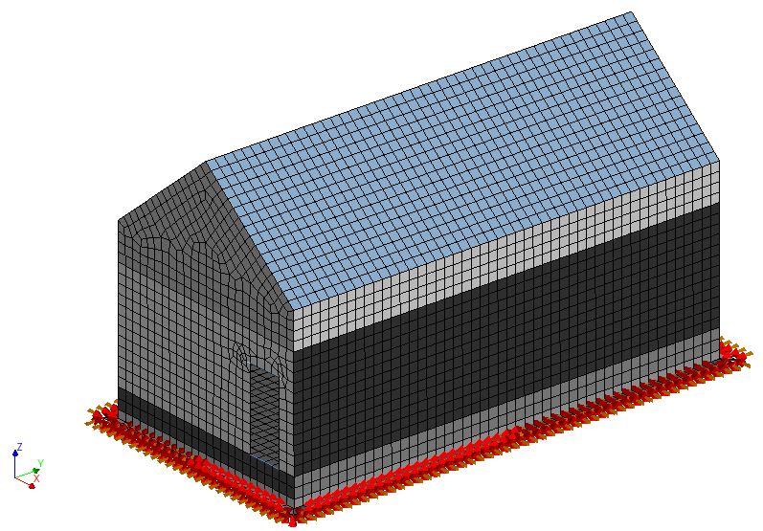
Supports
Protocol
Create fixed base supports (example for shallow foundations)
Provide numerical constraint for columns and beams (optional)
# Add fixed base supports for shallow foundation (to fstrip collection)
project.viia_create_supports('FixedBase’)
# Add boundary springs which prevent beams and columns from spinning
project.viia_create_all_boundary_springs_for_static_analysis(spring_stiffness=50)
29 June 2023

Slide 7
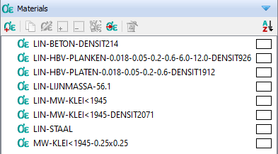
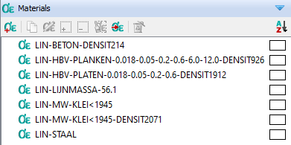
Linear materials
Protocol
Convert to linear material properties before analyses
(and back) afterwards
# For fixed base analysis set the materials (temporarily to linear)
project.viia_linear_properties()
project.viia_non_linear_properties()
29 June 2023

Slide 8
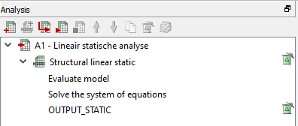
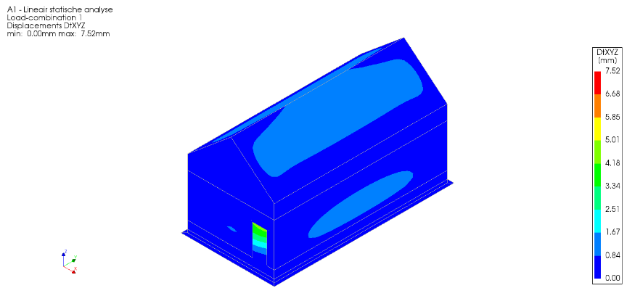
A1: Static analysis
Protocol
# Linear elastic static calculation (step A1 protocol)
if 'A1' in analysis:
project.viia_linear_properties()
project.viia_analysis(analysis_nr='A1', run=run_analysis)
project.viia_non_linear_properties()
= True to run directly in DIANA and handle results
00:00:00 Out-file of A1 - Lineair statische analyse moved to analysis folder.
00:00:00 Result-file of A1 - Lineair statische analyse is locked, a copy is made in analysis folder.
00:00:00 The sum of the vertical loads is 829.3 kN.
00:00:00 The center of mass is x: 2.993 m and y: 6.021 m.
00:00:00 Runtime of A1: 24.5 s
Geo engineer
29 June 2023

Slide 9
A2: Rob-test
Helps determine any errors in the model, such as loose elements.
If successfull, all elements in the model should displace exactly 1m.
if 'A2' in analysis:
project.viia_create_loads(load='Rob-test')
project.viia_create_loadcombination_rob_test()
project.viia_update_pile_supports_for_rob_test()
project.viia_analysis(analysis_nr='A2', run=run_analysis)
project.viia_remove_temporarily_pile_supports_for_rob_test()
project.viia_remove_loads(load_type='Rob-test')
project.viia_remove_loadcombination_rob_test()
= True to run directly in DIANA and handle results
29 June 2023

Slide 10
A3: Eigenfrequency analysis (fixed base)
# Eigenvalue analysis (step A3 protocol) (Optional)
if 'A3' in analysis:
project.viia_linear_properties()
project.viia_analysis(analysis_nr='A3', run=run_analysis, nmodes=num_modes)
project.viia_non_linear_properties()
= True to run directly in DIANA and handle results
Start with 10 modes
Check results and pictures for unusual behaviour:
Low eigenfrequencies are a sign of loose elements.
Large rotations of displacements can be a sign of errors in geometry or material properties.
Run then with 100 modes and later with 1000.
29 June 2023

Slide 11

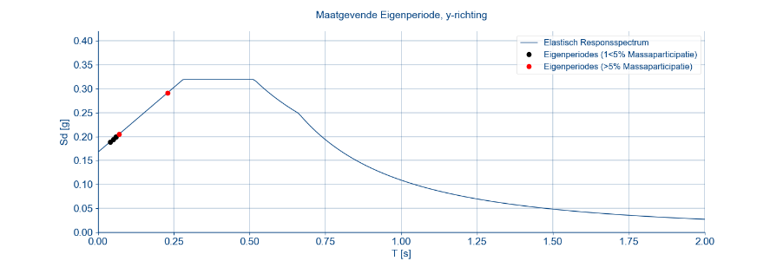
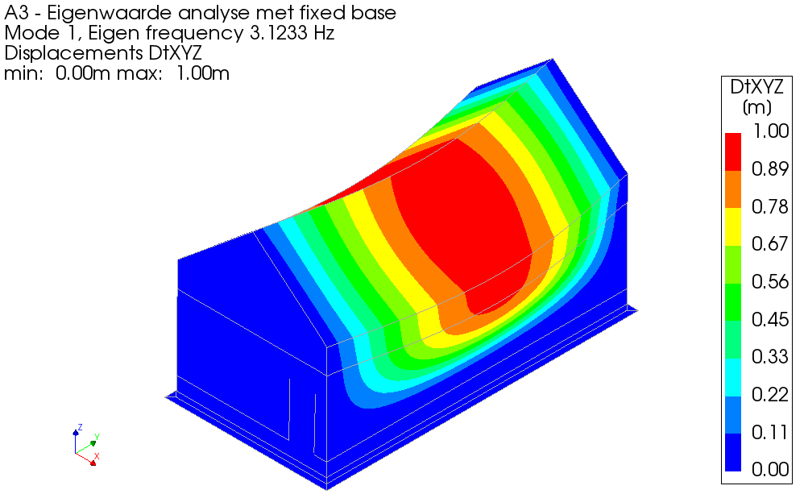
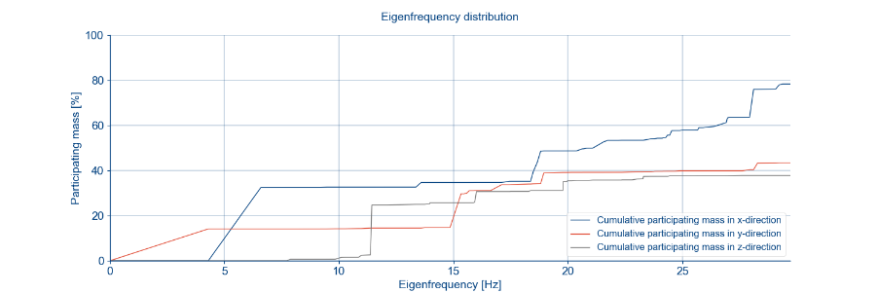
Exercise 4
Run the eigenfrequency analysis
29 June 2023

Slide 12
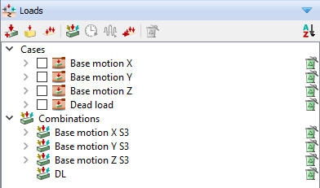
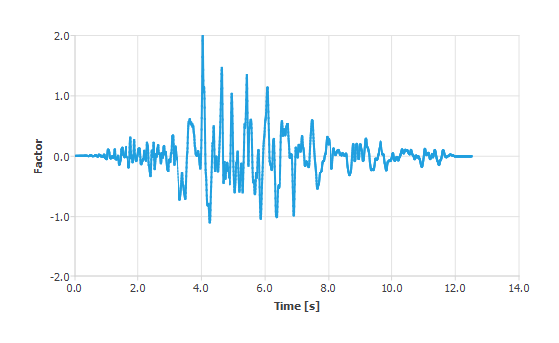
A4: Linear time-history
Protocol
Apply the base motions
if 'A4' in analysis:
project.viia_linear_properties()
project.viia_create_loads('Base motion')
project.viia_add_basemotion_signals()
project.viia_create_loadcombination_base_motion(signal[0])
project.viia_analysis(analysis_nr='A4', run=run_analysis, signals=signal)
project.viia_non_linear_properties()
= False. This analysis is run in the server
factor * ags * importance_factor * nlth_factor
Importance factor: Consequence class → CC1=1.0, CC2=1.1, CC3=1.2)
NLTH factor = 1.1 (7 signals)
ags (MYVIIA) → NEN cluster (MYVIIA)
9.84 m/s² * 0.1672g/1g * 1.1 * 1.1 = 1.99 m/s²
29 June 2023

Slide 13
VIIA Servers
Protocol
Request access to Reinier or Jurriaan
  WPS will create SZ1 credentials
  We will provide access to the server
  Move files: \\NLRTMGHPAPS004\exchange
Policy
  Stick to folder naming
  Don’t use as external disk
  Close all applications when you leave
  Empty recycle bin
  Sign out
29 June 2023

Slide 14

23 March 2022
29 June 2023

Slide 15
The VIIA team
29 June 2023

Slide 16
The process of an object
Strengthening
Cost engineer
Desk study
Proposal
Editors
Inspection
Engineering
Inspection report
Geo
29 June 2023

Slide 17
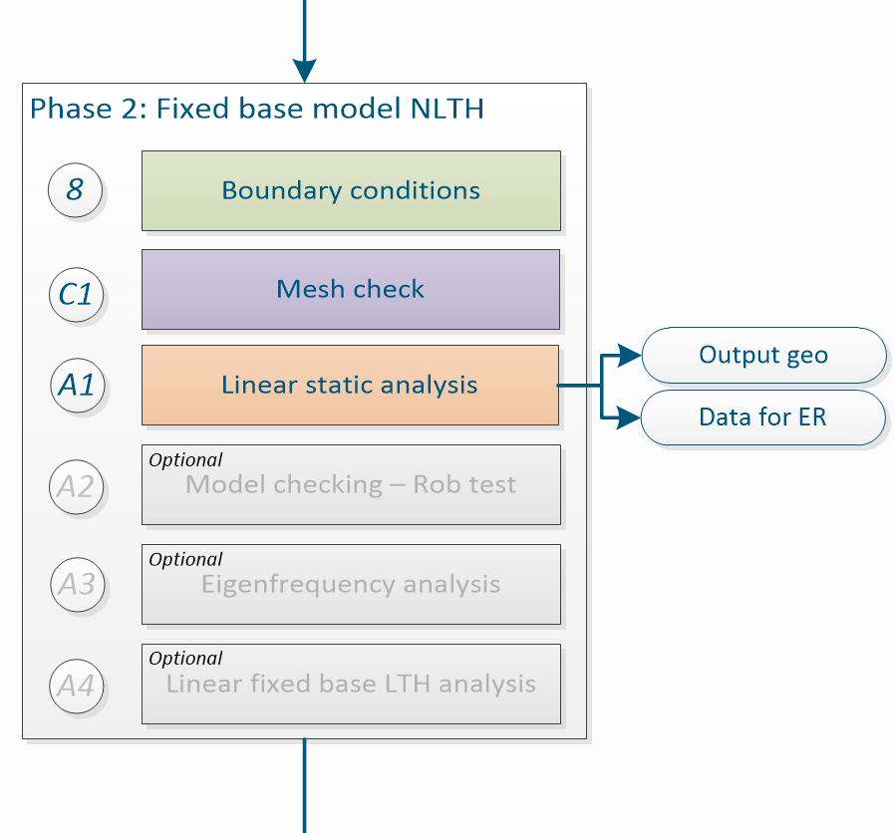
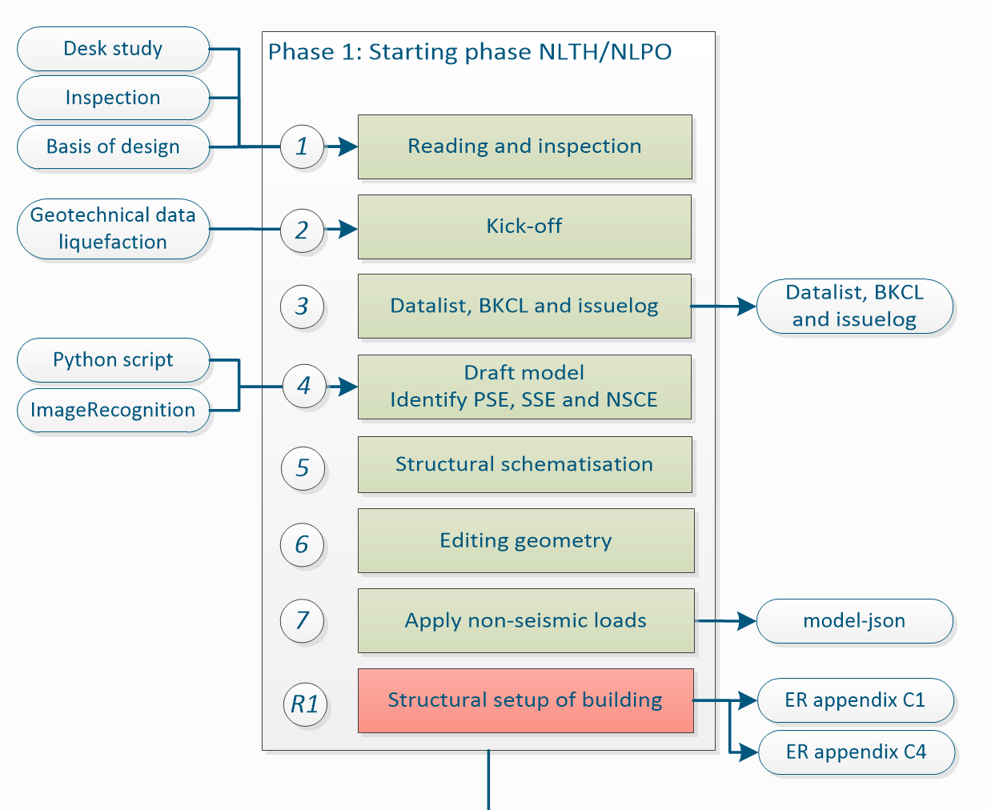
Engineering
Tender
29 June 2023

Slide 18
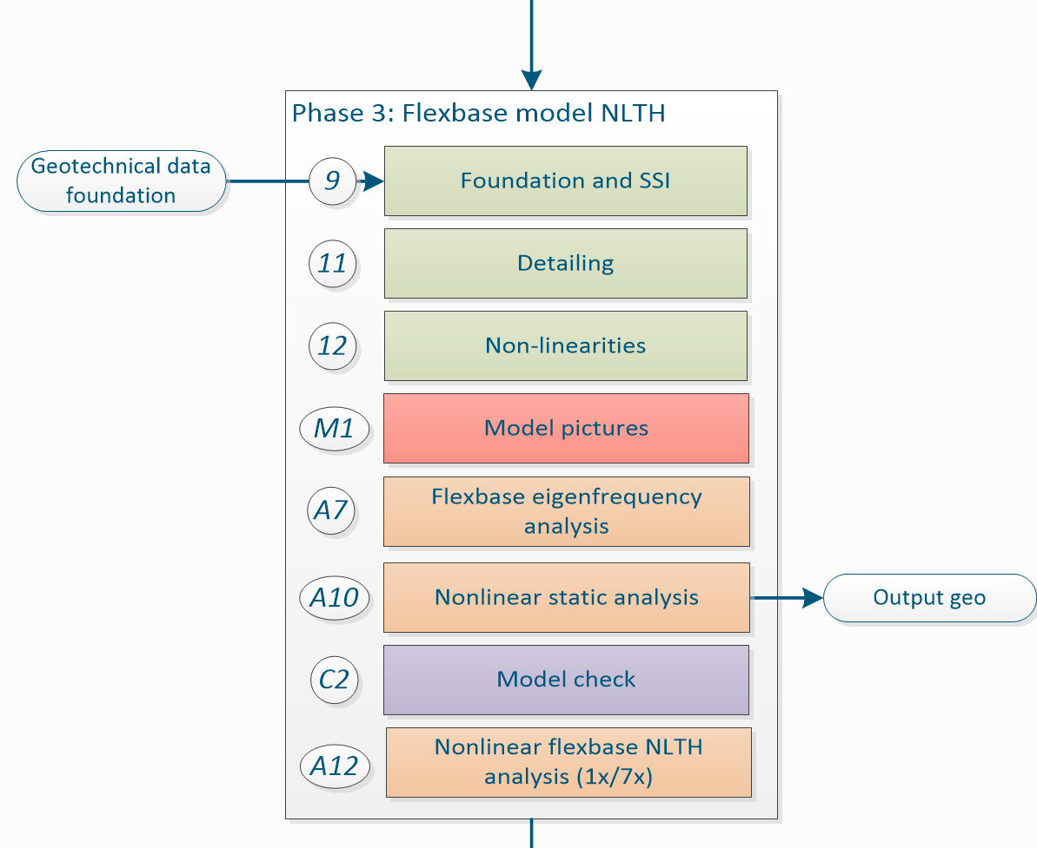
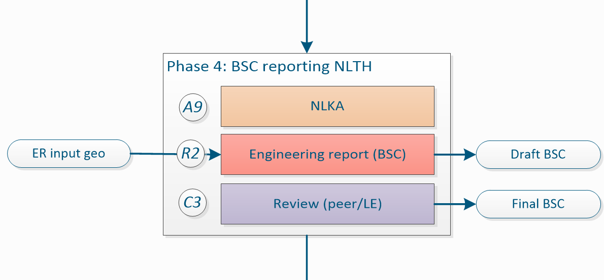
Engineering
Tender
29 June 2023

Slide 19
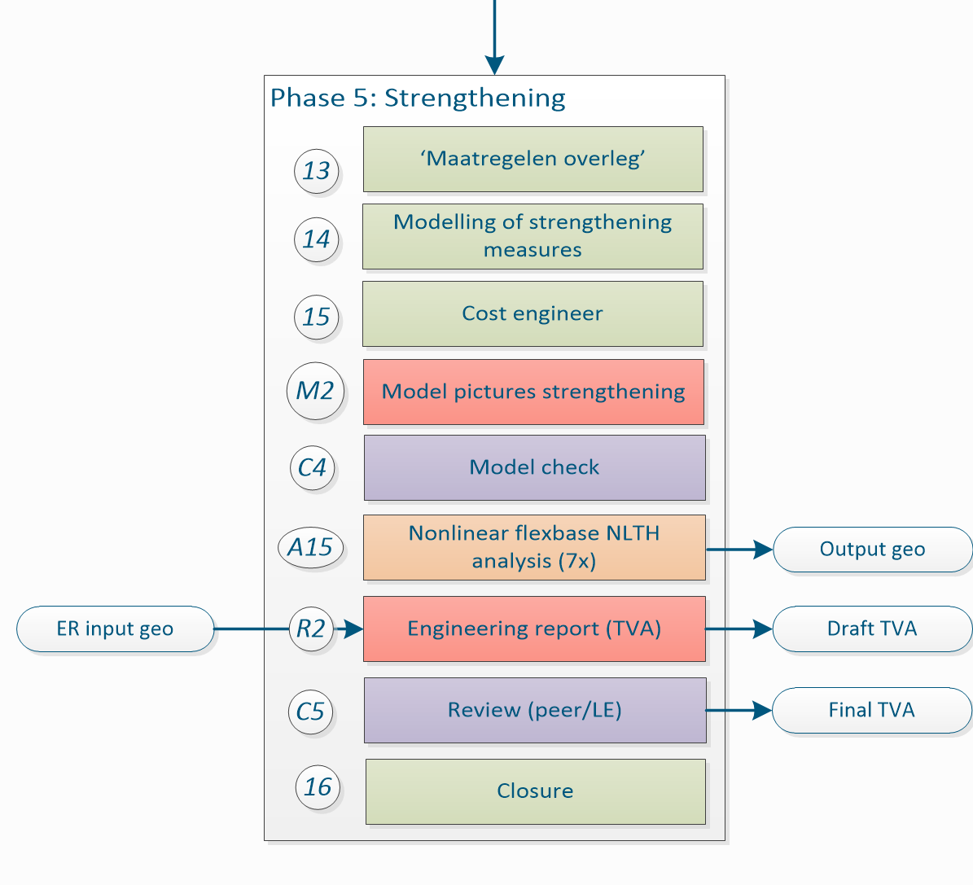
Engineering
Tender
29 June 2023

Slide 20
The team
Project leaders
Lead engineers
Cost engineers
Geo engineers
Inspectors
Technical masters
Knowledge team
Automation team

Slide 21
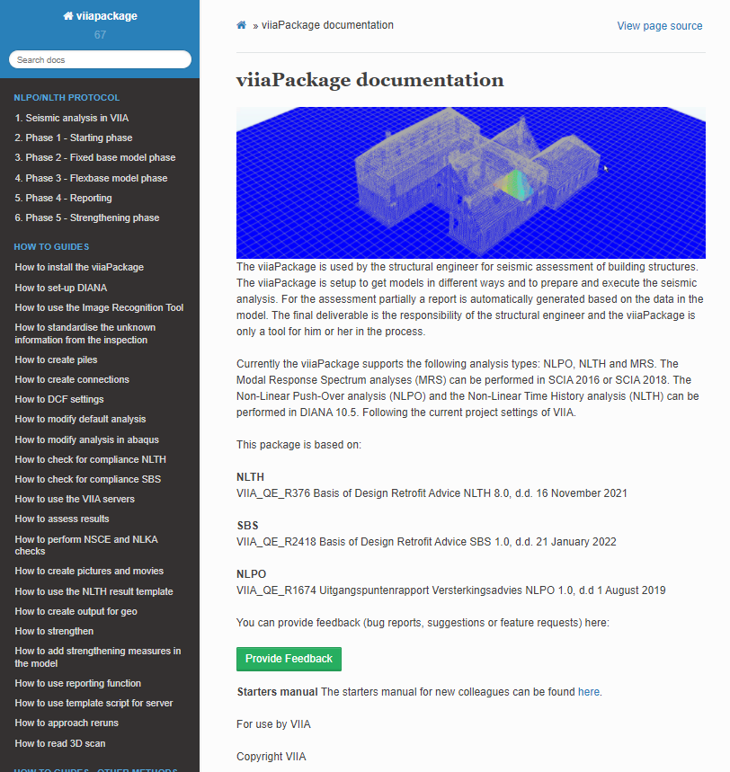
Reporting bugs / issue report
The issue report should provide:
name (without we cannot contact user and ask specifics),
scripts to reproduce the error (mainscript and model-json or modelscript) (if we can’t reproduce the error we will not be able to check if issue is solved),
clear description of the error encountered and why that is an error (sometimes we get remarks like the piles don’t work…),
clear description of the requirements of the solution (code-snippet if you solved the issue yourself),
environment: version of the fem-client and the version of the viiaPackage (including last date of updating the branch, or better the branch hash),
explanation of the attempts that have been undertaken to solve the issue.
29 June 2023

Slide 22
Flex base analyses
29 June 2023

Slide 23
Supports
Protocol
Creation of flexbase supports
# Create flexbase supports if any analysis is selected after A4
if any(a not in ['A1', 'A2', 'A3', 'A4'] for a in analysis):
# If there is pile foundation (use pile tool for sending data to MYVIIA first before creating flexbase piles)
# Delete this part if there are no piles in the model
project.viia_create_piles(coordinates=pile_coordinates, support_type='FlexBaseGlobal', pile_group='A')
# Shallow foundation interface for flex base
# Select for FexBaseGlobal or FlexBaseFinal (provide file from geotechnical adviser)
# Delete this part if there is no shallow foundation in the model
project.viia_create_supports(support_type='FlexBaseGlobal', material_file='USRDEF_XXXX_100%.dat')
'MATERI'
1 NAME USRDEF_940M_100%
DSNZ 4.15138E+08
DSSX 4.15138E+08
DSSY 4.15138E+08
RAYLEI 6.26231E-02 5.28754E-04
USRIFC COULOMB
USRVAL 5.2100E-01 1.5000E+05
USRSTA 0.0
'END'
29 June 2023

Slide 24
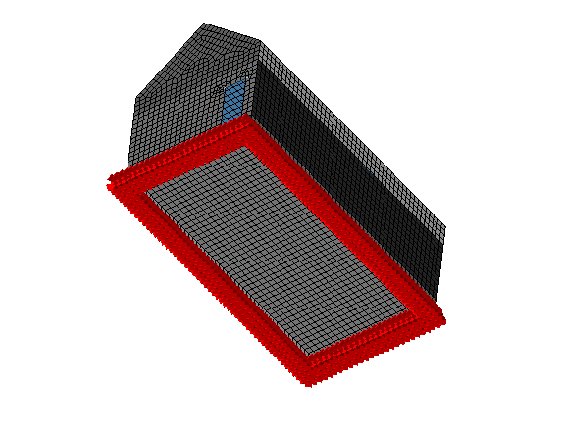
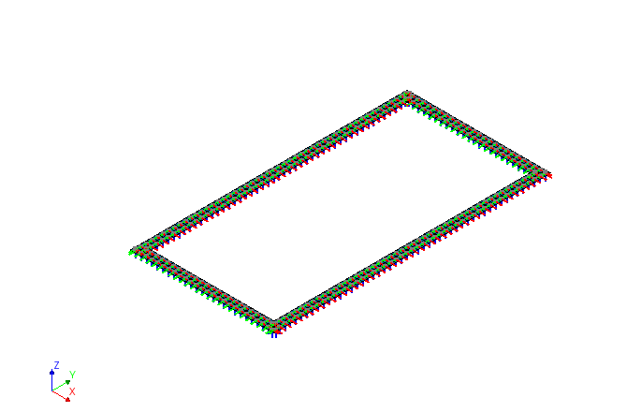
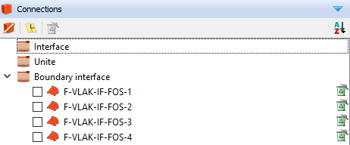
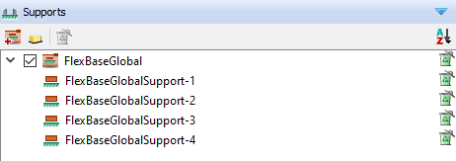
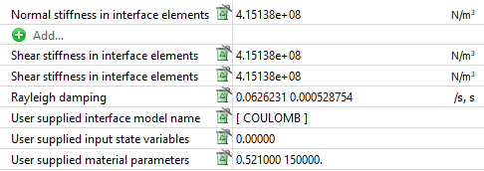
Supports
Protocol
Combination of Fixed support and interface (shallow foundation)/spring (pile foundation)
29 June 2023

Slide 25
A7: Eigenfrequency analysis (flex base)
= True. Run locally
# Eigenvalue analysis flexbase (step A7 protocol)
if 'A7' in analysis:
project.viia_analysis(analysis_nr='A7', run=run_analysis, nmodes=num_modes)
Protocol
Similar procedure as with the A3
Start with 10 modes
Check results and pictures for unusual behaviour
Run then with 100 modes and later with 1000.
29 June 2023

Slide 26
A10: Non-linear static analysis
= True. Run locally
# Nonlinear static flexbase analysis (step A10)
if 'A10' in analysis:
# Convert imposed loads to self weight (as extra density), imposed loads are created in modelscript
project.viia_convert_self_weight_to_imposed_loads()
project.viia_analysis(analysis_nr='A10', run=run_analysis)
project.viia_convert_imposed_loads_to_self_weight()
warnings.warn(f"Imposed Loads have been converted to self weight. If not running analysis directly "
f"(i.e. 'run_analysis' is set to False), then analysis is incorrect. Close DIANA and open A10 from "
f"{project.diana_settings.current_analysis_folder}")
Protocol
Similar procedure as with the A1
Check the results carefully (displacements, stresses, cracking, etc).
Check if deformed shape alligns with the location and behaviour of connections.
29 June 2023

Slide 27
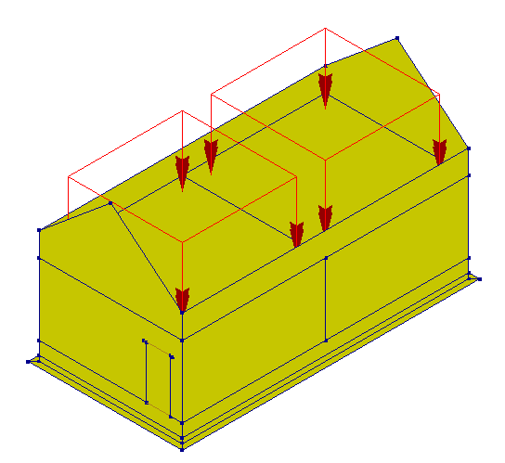
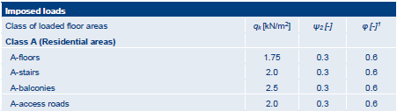
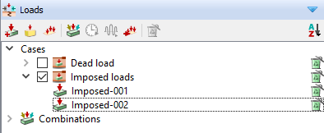
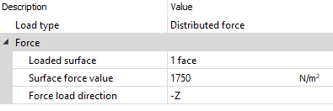
Loads
29 June 2023

Slide 28
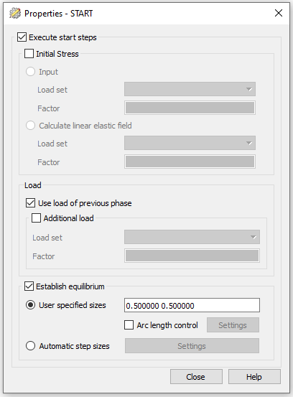
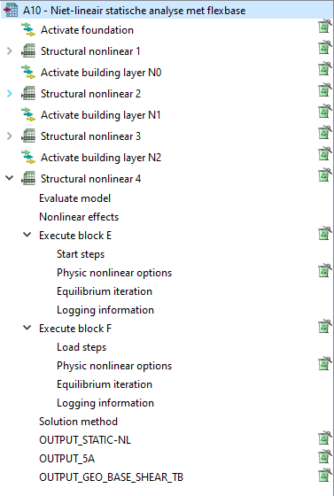
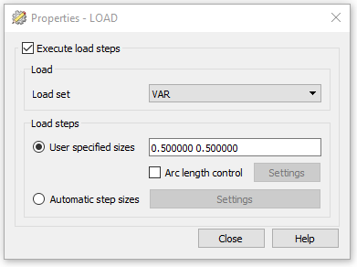
Loads
29 June 2023

Slide 29
Non-linear Time History analyses (A12)
Protocol
In A10:
# Nonlinear time history flexbase analysis (step A12)
if 'A12' in analysis:
project.viia_create_loads('Base motion')
project.viia_add_basemotion_signals()
project.viia_create_loadcombination_base_motion(signal[0])
project.viia_create_datfile()
project.viia_analysis(analysis_nr='A12', run=run_analysis, signals=signal)
In A12:
= False. Run in server
Check memory in the server before running the analysis!
When finished check all element results according to the UPR compliance criteria.
29 June 2023

Slide 30
Exercise 5
Create the A12 analysis for the workshop model in DIANA for
signal S3.
Bonus:
Change the iteration method to ‘secant’ through the viiaPackage.
29 June 2023

Slide 31
23 March 2022
29 June 2023

Slide 32
Result handling
29 June 2023

Slide 33
Summary
Protocol
Convergence graph
Base shear
Out-of-plane displacements
Result pictures
Acceleration graphs
Geo Output
29 June 2023

Slide 34
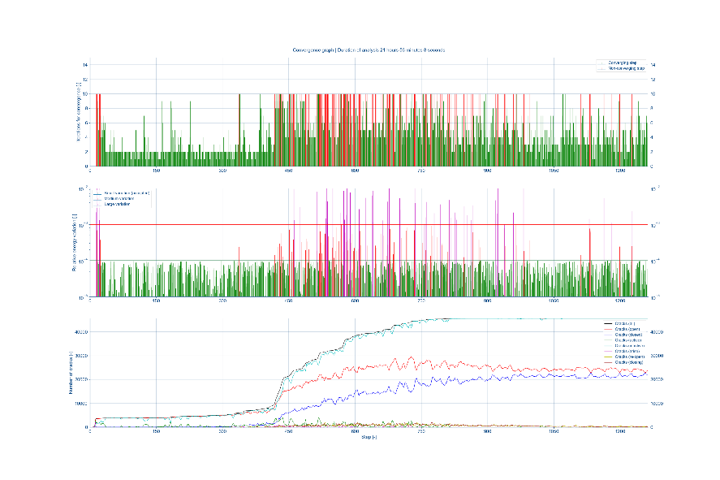
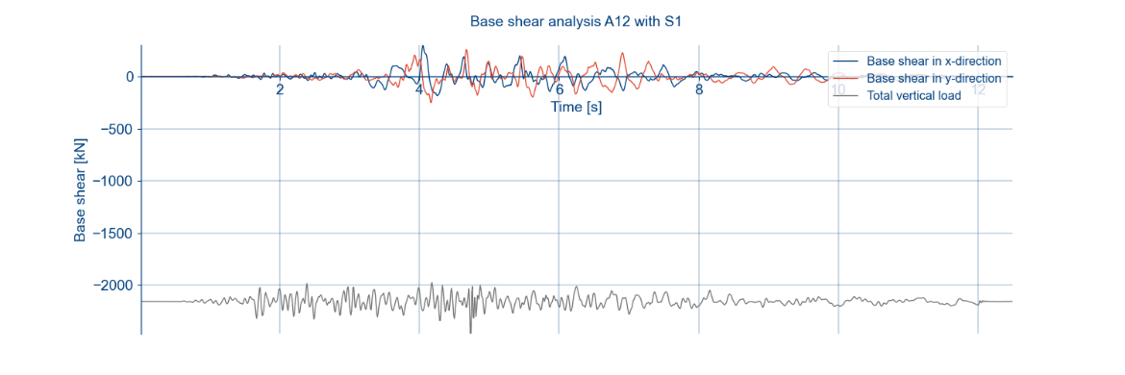
Convergence graph and base shear
29 June 2023

Slide 35
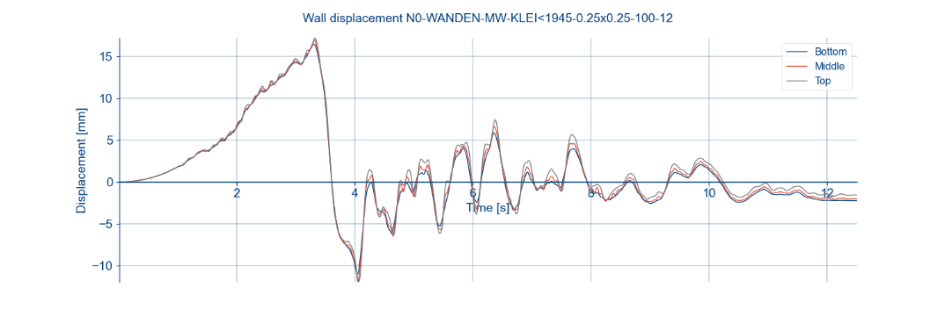
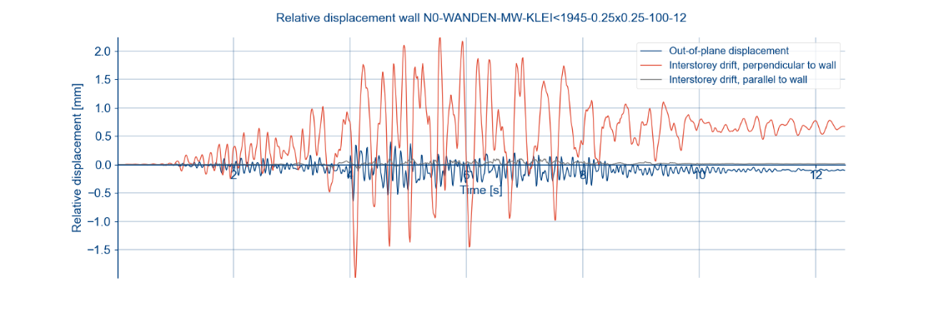
Out-of-plane displacements
29 June 2023

Slide 36
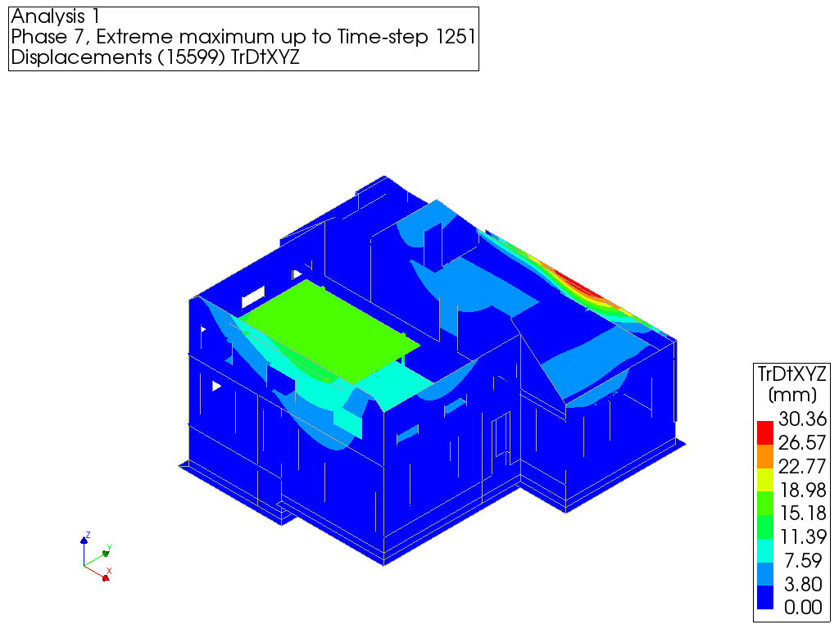
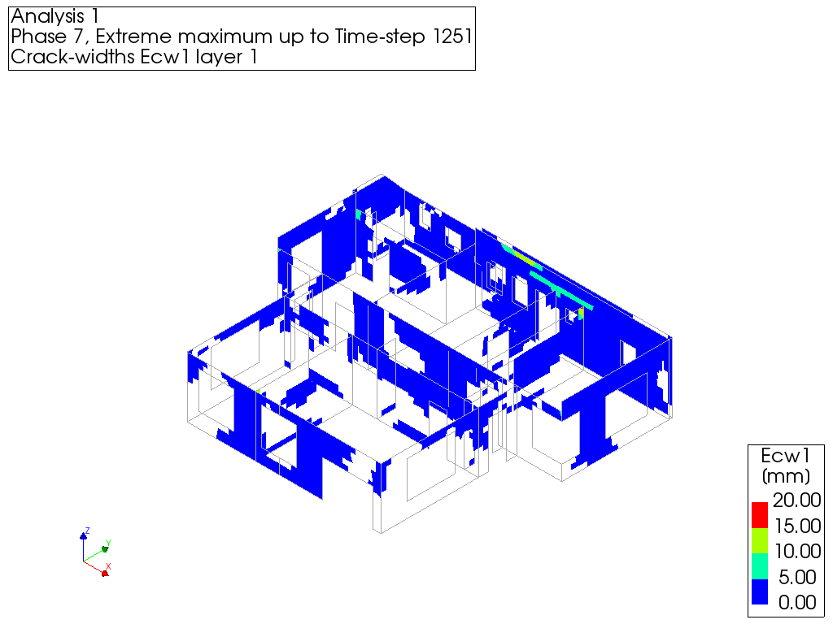
Result pictures
29 June 2023

Slide 37
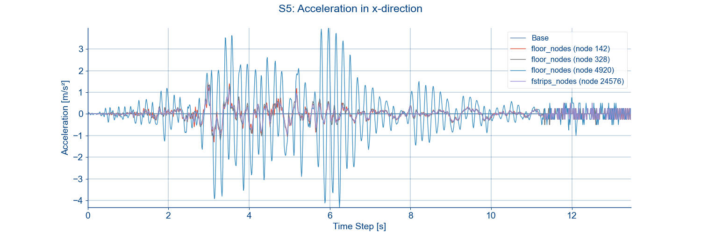
Acceleration graphs
Protocol
29 June 2023

Slide 38
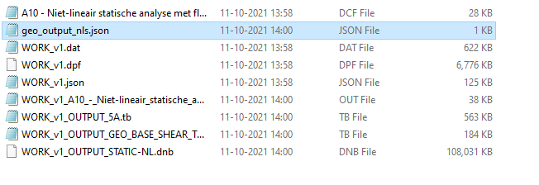
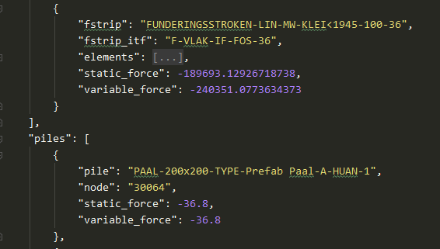
GeoOutput NLS
Protocol
When running A10 analysis, set ‘run_analysis’ to True. geo_output_ nls is automatically created in analysis folder.
Alternatively, this can be manually created
29 June 2023

Slide 39
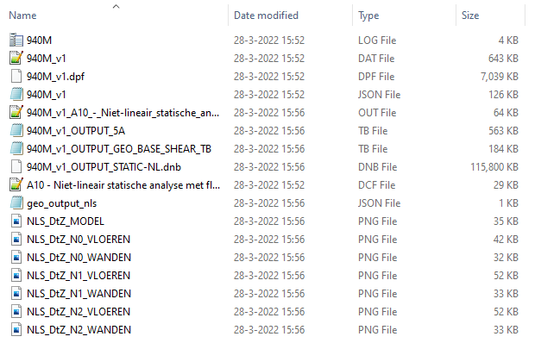
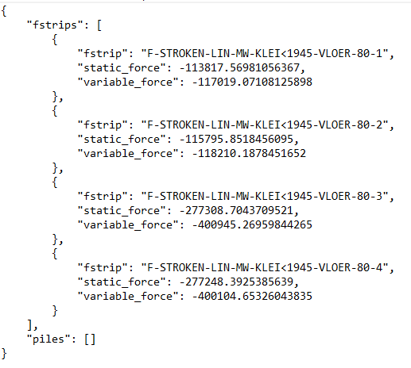
NLS results
Geo Output
Protocol
29 June 2023

Slide 40
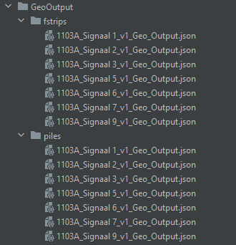
GeoOutput NLTH
Protocol
Through the result script
Specify signal (str), geo_output (bool), bsc_nls_dir(Path) and tva_nls_dir (Path)
29 June 2023

Slide 41
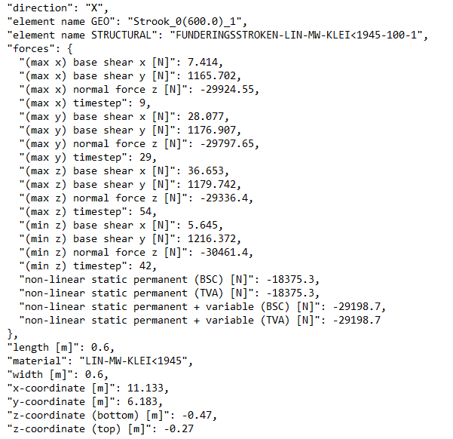
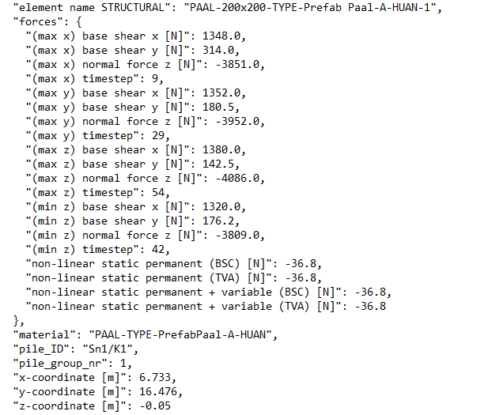
GeoOutput NLTH
29 June 2023

Slide 42
Strengthening
29 June 2023

Slide 43
Process
Protocol
Existing situation shows deficiencies (BSC report)
Select measures -> maatregelen overleg
GMC
Cost engineer → always! Even when no measures are needed
Add measures in model and analyses
Update version number
Measures in MYVIIA
29 June 2023

Slide 44
Result handling GeoOutput
No Strengthening - A10 for NLS and A12 for NLTH (version number: 1)
With Strengthening – A13 for NLS and A15 for NLTH (version number: 2)
In case strengthening is applied with no significant change in mass, specify tva_nls_dir same as bsc_nls_dir
29 June 2023

Slide 45
Reporting
29 June 2023

Slide 46

Report and appendices
Protocol
BSC
  Beoordeling Seismische Capaciteit
TVA
  Technisch VersterkingsAdvies
29 June 2023

Slide 47
Requirements for viia_create_report() for NLTH
Protocol
General information is retrieved from MYVIIA
Analyses folders (including images) for:
  A7 – Eigenvalue flex base
  A10 – NLS flex base
  A12 – NLTH flex base
29 June 2023

Slide 48
REF approach method
29 June 2023

Slide 49
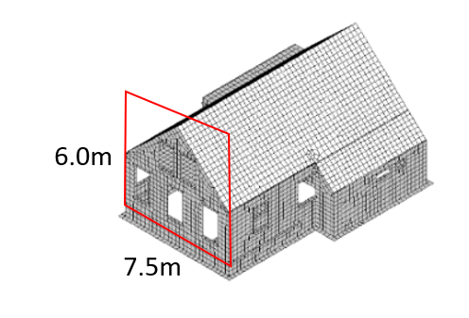
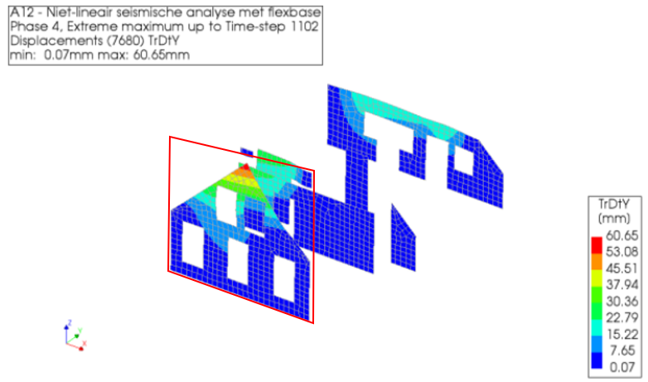
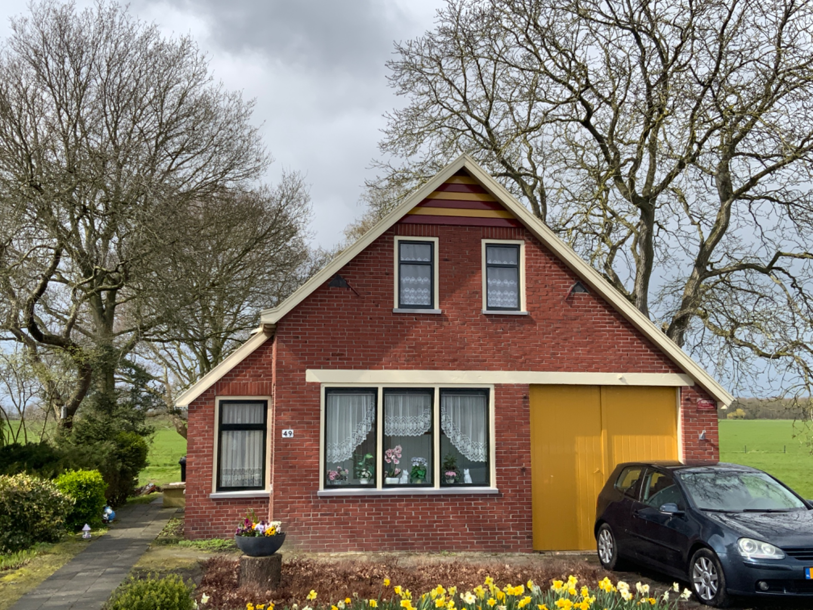
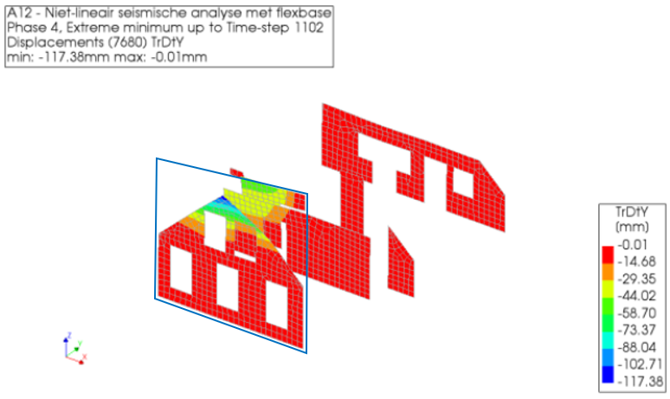
What is it?
Assessment of residences using previously assessed structures as reference.
Reference buildings must be representative.
No FEM model is created.
Governing elements are identified for different failure mechanisms
Existing results are used to draw conclusions.
Main properties of interest:
  PGA,
  overal dimensions of the structure,
  global and/or local geometry and material of walls, floors and roofs.
Floor-1
OOP-Wall2
6.0 m
7.0 m
29 June 2023

Slide 50
Thanks, we hope you enjoyed this workshop!
29 June 2023

